Slide 1
EASY ENGLISH GRADE 8
ZONAL EDUCATION OFFICE- EMBILIPITIYA
Prepared by – Ms. D.A.N.Lakmali
R/Emb/Mulendiyawala M.V.

Slide 2
UNIT- 03 LET’S BE CONSIDERATE
Activity -3.5
Competency Level – 5.5 Read & responds to simple folk stories/stories.

Slide 3
Number the sentences in the correct order to form the story.
He ruled his country justly, but his countrymen didn’t follow his orders.(…….)
One day, the king summoned a great wizard who was known to be the wisest man in the kingdom.(………)
Once upon a time there was a king who had a strange problem.(……1….)
However, since he was a just king, he didn’t want to punish his people only for not following his orders.(…….)
Meanwhile a young man came to the palace & said that he possessed powerful magical magical powers that could solve the king’s problem.(………)
Even though the old wizard did his spell it didn’t work.(………)
The king asked the wizard if he could cast a spell that would make the people of this kingdom obey his orders.(…….)
The young man said, “my friend I’m not a wizard, I’m a teacher. What I wrote on these parchments were not magic utterances. But polite words.(……..)

Slide 4
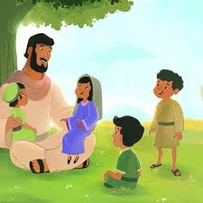
Before long all the citizens began to obey the king.(…………..)
Upon hearing this the old wizard wanted to know about the magic.(…………)
The king was very excited and decided to speak according to the young man.(……)
Amazing! Within a few minutes, the servant was in front of the king with a platter of food.(………..)
The young man got king’s permission to start his work immediately.(……)
The king saw a servant passing by and said the first word and asked him to bring a platter of food.(…….)
In a very short time the young man came to the king with two small parchments and gave his spells.(……)
The first was “please” and the second was “thank you”. (…….)

