Slide 1
EASY ENGLISH GRADE 08
ZONAL EDUCATION OFFICE – EMBILIPITIYA
Prepared by- Ms.D.A.N.Lakmali
R/Emb/Mulendiyawala M.V.

Slide 2
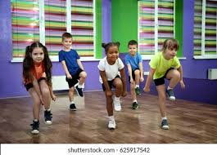
Unit10 Beyond the classroom.
Activity 10.6
Competency level- 2.5 Uses inverted commas appropriately

Slide 3
Let’s use inverted commas.
Ex. Kavith said, “ I am hungry”
We use inverted commas (quotation marks) when we are quoting the exact words of a speaker or writer.
As well as ,
To mark a certain word or a phrase that’s being quoted from another place or person. We also use the inverted commas to mark a significant word or phrase in a sentence
Ex- We call this phenomenon “The water cycle.”

Slide 4
Use inverted commas correctly.
Ex. The customer explained, This is not working. Can I have a replacement please.
The customer explained, “This is not working. Can I have a replacement please”.
I have just finished reading this book, said Vindya.
Is this way to the hospital? I am lost, inquired Chethika.
People in the audience were yelling, More! We want more!.
My teacher always says , Words and ideas can change the world.
She asked, What’s your brother’s name?.

