Slide 1
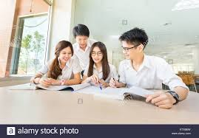
EASY ENGLISH GRADE 8
ZONAL EDUCATION OFFICE – EMBILIPITIYA
Prepared by – Ms. D.A.N.Lakmali
R/Emb/ Mulendiyawala M.V.

Slide 2
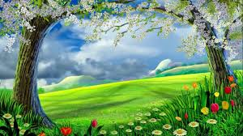
UNIT 04 MOTHER NATURE
Activity – 4.3
Competency Level – 5.3 Transfers Information in to other forms.

Slide 3
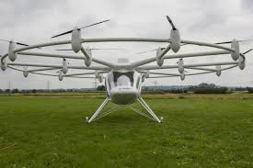
Nature inspired creations.
Flying Machines.
Birds’ streamlined body shape
Leonardo da Vinci analyzed the flight of birds and adapted it for the construction on flying machines.
On the arrangement of wings and feathers.

Slide 4
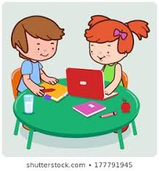
Let’s write a small paragraph on “flying machines”.

Slide 5
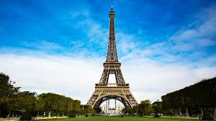
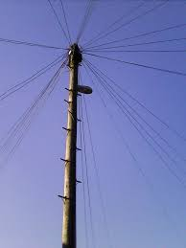
Architectural monuments based on nature.
Eiffel Tower
Based on the structure of the human bone tissue
Telegraph Poles
Method of wind resistance similar to blades of grass

Slide 6
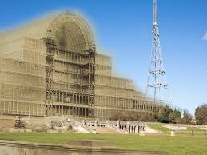
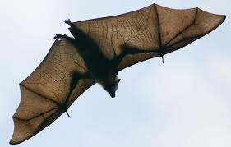
Crystal Palace
Designed by Joseph Paxton.
In London
Used the leaves of the tropical water lily as model
Bats
Diagnosis of diseases through ultra sound

Slide 7
Write a small paragraph on “architectural monuments based on nature”.

