Slide 1
EASY ENGLISH GRADE 8
ZONAL EDUCATION OFFICE – EMBILIPITIYA
Prepared by –Ms. D.A.N.Lakmali
R/Emb/ Mulendiyawala M.V.

Slide 2
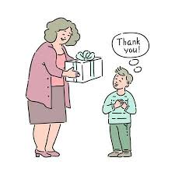
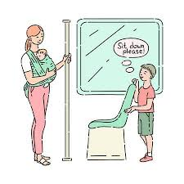
UNIT – 03 LET’S BE CONSIDERATE
Activity – 3.3
Competency level – Uses conjunctions appropriately.

Slide 3
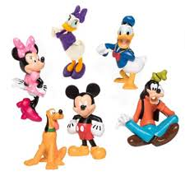
Let’s learn conjunctions.
fat - one word
Short – one word
Fat and short – two words.
The boy – one phrase
The old lady – one phrase
The boy and the old lady – two phrases
Waruni is poor- one clause
She is happy- one clause
Waruni is poor but she is happy.- two clauses.
A conjunction is a word that links two words, two phrases, or two clauses.

Slide 4
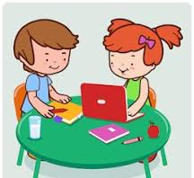
There are three types of conjunctions.
conjunctions
Coordinating conjunctions.
Correlating conjunctions
Subordinating conjunctions
Eg. And, but, then, yet etc..
Eg. Either- or, neither-nor etc..
Eg. Although, while, unless etc..

Slide 5
As well as, conjunctions can also be classified according the meaning they convey.
Conjunctions of time – before, after, when etc..
Conjunctions of addition – and, also, too etc..
Conjunctions of reason –because, as, since, for
Conjunctions of contrast – but, although etc..
Conjunctions of result – so, so…that etc…

Slide 6
Let’s learn conjunctions of reason.
Since
Eg.
I have been very busy since I started my new job.
I’ll stay home and watch a film since it’s raining.
As
Eg.
She may need some help as she’s new.
They did as I had asked.
We use since ,as to give reason for something.

Slide 7
Join two sentences using “since” and “as”.
A | B
I don’t want to interfere | It will balance the bio diversity.
I hurried up | It’s not my responsibility
You must look after your grand father | She woke up late
We must plant more trees | He is helpless.
She missed the school bus | There was so much work to do
Eg.
I don’t want to interfere as it is not my responsibility.
Since it is not my responsibility I don’t want to interfere.

Slide 8
Let’s learn conjunctions of result
So
Eg-
It was still painful , so I went to see a doctor.
The programme has been well organized, so none of the talk overlap.
My dear children, do not forget to put a comma before the conjunction.

Slide 9
Join two sentences using “so”
A | B
It’s raining heavily | I have stopped eating chocolate.
I gave you a map | I phoned the police.
The engine drivers were on a strike | You wouldn’t get lost.
I’m on a diet | The railway station was crowded with people.
I saw a robbery | The river is in flood.
Eg-
It’s raining heavily, so the river is in flood.

