Slide 1
EASY ENGLISH GRADE 8
ZONAL EDUCATION OFFICE- EMBILIPITIYA
Prepared by – Ms. D.A.N.Lakmali
R/Emb/mulendiyawala M.V

Slide 2
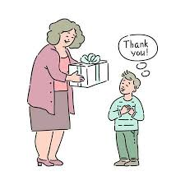
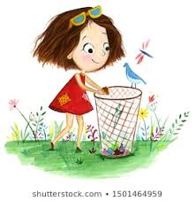
UNIT 3 LET’S BE CONSIDERATE
Activity- 3.6
Competency Level – 6.5 Uses contracted forms

Slide 3
Let’s learn contracted forms (short forms)
I am
Long form
I’m
contracted form (Short form)
We use apostrophe to show omission of the letter.
Long form | Contracted form
I am | I’m
He is | He’s
She is | She’s
It is | It’s
We are | We’re
They are | They’re
You are | You’re

Slide 4
Negative statement
Long form | Short form
I am not | I’m not
He is not | He isn’t or He’s not
She is not | She isn’t or she’s not
It is not | It isn’t or It’s not
We are not | We aren’t or we’re not
They are not | They aren’t
You are not | You aren’t or you’re not
Long form | Short form
I do not | I don’t
He does not | He doesn’t
She does not | She doesn’t
It does not | It doesn’t
You do not | You don’t
We do not | We don’t
They do not | They don’t

Slide 5
Long form | Short form
I was not | I wasn’t
He was not | He wasn’t
She was not | She wasn’t
It was not | It wasn’t
You were not | You weren’t
We were not | We weren’t
They were not | They weren’t
Long form | Short form
I did not | I didn’t
He did not | He didn’t
She did not | She didn’t
We did not | We didn’t
You did not | You didn’t
It did not | It didn’t
They did not | They didn’t

Slide 6
Has/Have
Positive statement |  | Negative statement
Long form | Short form | Long form | Short form
I have | I’ve | I have not | I haven’t or I’ve not
He has | He’s | He has not | He hasn’t or He’s not
She has | She’s | She has not | She hasn’t or she’s not
It has | It’s | It has not | It hasn’t or It’s not
You have | You’ve | You have not | You haven’t or You’ve not
We have | We’ve | We have not | We haven’t or we’ve not
They have | They’ve | They have not | They haven’t or they’ve not

Slide 7
Other negative forms
Long form | Short form | Long form | Short form
Will not | Won’t | Had not | Hadn’t
Would not | Wouldn’t | Must not | Mustn’t
Can not | Can’t | Shall not | Shan’t
Could not | Couldn’t | Should not | Shouldn’t

Slide 8
Let’s write these sentences using contracted forms.
Let us go out. - ex. Let’s go out.
They will not be late…………….
You are late………………………..
It is very nice…………….
He will come………….
Do not open the door……….
I was not angry…………………..
He is having a bath………………….
I shall not come…………………….
We can not do this sum………………..

