Slide 1
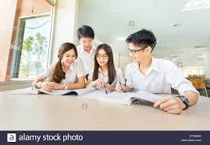
EASY ENGLISH GRADE 8
ZONAL EDUCATION OFFICE- EMBILIPITIYA
Prepared by- Ms.D.A.N.Lakmali
R/Emb/Mulendiyawala M.V.

Slide 2
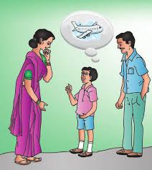
UNIT 05 BETWEEN THE MILES
Activity 5.1
Competency Level 5.1Transfers information into other forms.

Slide 3
Read the text and complete the following sentences.
Lahiru’s pen friend is …………………..
Kenta Akimoto lives in ………………………
It’s nearly……………km from Nagoya to Sri Lanka.
They are taking a …………. Flight to Colombo.
The flight will take about ………….

