Slide 1
EASY ENGLISH GRADE 8
ZONAL EDUCATION OFFICE –EMBILIPITIYA
Prepared by- Ms.D.A.N. Lakmali
R/Emb/Mulendiyawala M.V.

Slide 2
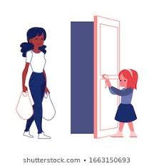
UNIT 03 LET’S BE CONSIDERATE
Activity -3.7
Competency Level – Forms the plurals of nouns.

Slide 3
LET’S LEARN UNCOUNTABLE NOUN – PLURAL FORM
A non- count noun is something we don’t count. It has no plural form.
However,
We use quantifiers when talking about plurals of these words.
A glass of water
singular
Three glasses of water
plural

Slide 4
Let’s write the plural forms of the uncountable nouns
A loaf of bread – two loaves of bread
One piece of cake – three …………………….
A packet of milk – six ……………………………..
A sheet of paper – four ………………………….
One spoon of sugar –three ………………..
A pot of curd – seven ……………………………
A kilo of carrots – two ………………………….
A bag of rice – six ……………………………..

