Slide 1
EASY ENGLISH GRADE 8
ZONAL EDUCATION OFFICE- EMBILIPITIYA
PREPARED BY- MS. D.A.N. LAKMALI
R/EMB/ MULLENDIYAWALA M.V.

Slide 2
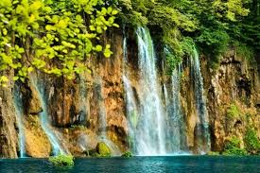
UNIT 04 MOTHER NATURE
Activity -4.4
Competency Level – 5.4 Reads and responds to simple poems.

Slide 3
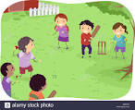
Underline the correct answer.
How many stanzas are there in this poem?
04 (b)16
2. What is the name of the poet?
(a) William Blake (b) A Nurse’s song
3. Find the rhyming words.
Rest –breast (b) day – bed
4. Which lines say that the children don’t like to stop playing?
9 and 10 (b) 5 and 6
5. What is the poem about?
It is about a nurse and a group of patients.
It is about an unpretentious encounter between a nurse and a group of children who are playing on a hill.

