Slide 1
වදන් සැකසීම
8 ශ්‍රේණිය
ර/ඇඹි/ඇඹිලිපිටිය මහා විද්‍යාලය -8 ශ්‍රේණිය

Slide 2
එකෙල්ල කිරීමේ සහ ස්ථානගත කිරීමේ මෙවලම්
Alignment and positioning Tools
තොරතුරු හා සන්නිවේදන තාක්ෂණය-8 ශ්‍රේණිය

Slide 3
මැදට එකෙල්ල කිරීම
Center
TEXT
දකුණට එකෙල්ල කිරීම
Align Right
වමට එකෙල්ල කිරීම
Align Left
තොරතුරු හා සන්නිවේදන තාක්ෂණය-8 ශ්‍රේණිය
Notes:
Animated rectangles curve up and grow in sequence
(Intermediate)
To reproduce a rectangle on this slide, do the following:
On the Home tab, in the Slides group, click Layout, and then click Blank.
On the Home tab, in the Drawing group, click Shapes, and then under Rectangles click Rounded Diagonal Corner Rectangle (ninth option from the left). On the slide, drag to draw a rounded rectangle.
Drag the yellow diamond adjustment handle to the left to reduce the size of the corner radius.
Select the rounded rectangle. Under Drawing Tools, on the Format tab, in the Size group, do the following:
In the Shape Height box, enter 2.33”.
In the Shape Width box, enter 2.32”.
On the Home tab, in the Drawing group, click the arrow next to Shape Fill, and select No Fill.
On the Home tab, in the Drawing group, click Shape Effects, point to Reflection, under Reflection Variations, select Tight Reflection, touching (first row, first option from the left).
On the Home tab, in the bottom right corner of the Drawing group, click the Format Shape dialog box launcher.
In the Format Shape dialog box, in the left pane click Line Color, and then in the Line Color pane select Solid Line. In the Color list, select More Colors, and then in the Colors dialog box, on the Custom tab, enter values for Red: 137, Green: 227, Blue: 231.
Also in the Format Shape dialog box, in the left pane, click Line Style. In the Line Style pane, in the Width text box, enter 10 pt, and in the Cap type list, select Round.
Also in the Format Shape dialog box, in the left pane, click 3-D Format. In the 3-D Format pane, do the following:
Under Bevel, do the following:
In the Top list, under Bevel, select Circle (first row, first option from the left).
In Top, under Width, enter 10 pt.
In Top, under Height, enter 10 pt.
Under Contour, click the button next to Color, and then under Theme Colors select Olive Green, Accent 3, Lighter 60% (third row, seventh option from the left).
Under Surface, do the following:
In the Material list, under Standard, select Matte (first row, first option from the left).
In the Lighting list, under Neutral, select Soft (first row, third option from the left).
In the Angle box, enter 315°.
Right-click the rounded rectangle and select Edit Text.
Enter text in the text box, select the text, and then on the Home tab, in the Font group, select Gills Sans MT Condensed from the Font list, and select 28 from the Font Size list.
On the Home tab, in the Paragraph group, click Center to center the text.
To reproduce the animation effect on this slide, do the following:
On the Animations tab, in the Animation group, click the More arrow to expand the effects gallery, and then click More Entrance Effects. In the Change Entrance Effect dialog box, under Exciting, click Curve Up.
In the Timing group, do the following:
In the Start list, select With Previous.
In the Duration list, select 00.50.
In the Advanced Animation group, click Add Animation, and under Emphasis, click Grow/Shrink.
In the Advanced Animations group, click Animation Pane. In the Animation Pane, click the arrow at the side of the second (grow/shrink) effect and then click Effect Options.
In the Grow/Shrink dialog box, on the Timing tab, do the following:
In the Start list, select With Previous.
In the Duration list, select 0.5 seconds (Very Fast).
On the Effects tab, do the following:
Click the arrow next to Size, select Custom, enter 5 and then press ENTER.
Click the arrow next to Size, select Vertical.
Select the Auto-reverse check box.
Click OK.
To reproduce a second and third rectangle and the animation, do the following:
On the slide, select the rounded rectangle.
On the Home tab, in the Clipboard group, click the arrow at Copy, and select Duplicate. Position the second rounded rectangle next to the first rounded rectangle. Repeat until there are three rectangles.
In the Animation Pane, in the animation list, press and hold CTRL and select the Curve Up entrance effect and Grow/Shrink emphasis effect for the second rectangle (third and fourth effects in the list). On the Animations tab, in the Timing group, in the Delay text box, enter 0.5.
In the Animation Pane, in the animation list, press and hold CTRL and select the Curve Up entrance effect and Grow/Shrink emphasis effect for the third rectangle (fifth and sixth in the list). Click the arrow next to the effect, select Effect Options, and then in the dialog box, on the Timing tab, in the Delay text box, enter 1.0.
Click the text in each rectangle to change, add or remove it.
To reproduce the background on this slide, do the following:
On the Home tab, in the Drawing group, click Shapes, and then under Rectangles, select Rectangle (first option from the left). On the slide, drag to draw a rectangle.
Select the rectangle. Under Drawing Tools, on the Format tab, in the Size group, do the following:
In the Shape Height text box enter 1.62”.
In the Shape Width text box enter 10”.
Under Drawing Tools, on the Format tab, in the bottom right corner of the Shape Styles group, click the Format Shape dialog box launcher.
In the Format Shape dialog box, in the left pane, click Fill, and in the Fill pane, do the following:
Select Solid fill.
Click the button next to Color, select More Colors, and then in the Colors dialog box, on the Custom tab, enter values for Red: 137, Green: 227, Blue: 231.
Under Transparency, use the slider or box to enter 70%.
Also in the Format Shape dialog box, in the left pane, click Line Color, and in the Line Color pane, select No line.
Position the rectangle on the middle of the slide.
On the Home tab, in the Drawing group, click Shapes, and then under Rectangles, select Round Diagonal Corner Rectangle (ninth option from the left). On the slide, drag to draw a rectangle
Select the round diagonal corner rectangle. Under Drawing Tools, on the Format tab, in the Size group, in the Shape Height text box enter 0.44” and in the Shape Width text box enter 0.44”.
Under Drawing Tools, on the Format tab, in the Shape Styles group, click the Format Shape dialog box launcher.
In the Format Shape dialog box, in the left pane, click Fill, and in the Fill pane, do the following:
Select Solid fill.
Click the button next to Color, under Theme Colors, select White, Background 1, Darker 15% (third row, first option from the left).
In the Transparency, box enter 60%.
Also in the Format Shape dialog box, in the left pane, click Line Color, and in the Line Color pane, select No line.
Select the round diagonal corner rectangle. On the Home tab, in the Clipboard group, click the arrow at Copy, and select Duplicate. Repeat this process until you have a total of seven round diagonal corner rectangles.
On the slide, press and hold CTRL and select the seven round diagonal corner rectangles. On the Home tab, in the Drawing group, click Arrange, and then under Position Objects, point to Align, and do the following:
Click Align Selected Objects.
Click Align Top.
Click Distribute Horizontally.
Right-click the slide background area, and then click Format Background. In the Format Background dialog box, click Fill in the left pane, select Gradient fill in the Fill pane, and then do the following:
In the Type list, select Linear.
Click the button next to Direction, and then click Linear Diagonal – Bottom Right to Top Left (second row, third option from the left).
Under Gradient stops, click Add or Remove until two stops appear on the slider, and customize the gradient stops as follows:
Select Stop 1 on the slider, and then do the following:
In the Position box, enter 50%.
Click the button next to Color, and click White, Background 1 (first row, first option from the left).
Select Stop 2 on the slider, and then do the following:
In the Position box, enter 100%.
Click the button next to Color, and click More Colors. In the Colors dialog box, on the Custom tab, enter values for Red: 204, Green: 244, Blue: 248.

Slide 4
පේළි අතර පරතරය වෙනස් කිරීම
Line Spacing
TEXT
බුලට්
Bullets
දෙපසට එකෙල්ල කිරීම
Justify
තොරතුරු හා සන්නිවේදන තාක්ෂණය-8 ශ්‍රේණිය
Notes:
Animated rectangles curve up and grow in sequence
(Intermediate)
To reproduce a rectangle on this slide, do the following:
On the Home tab, in the Slides group, click Layout, and then click Blank.
On the Home tab, in the Drawing group, click Shapes, and then under Rectangles click Rounded Diagonal Corner Rectangle (ninth option from the left). On the slide, drag to draw a rounded rectangle.
Drag the yellow diamond adjustment handle to the left to reduce the size of the corner radius.
Select the rounded rectangle. Under Drawing Tools, on the Format tab, in the Size group, do the following:
In the Shape Height box, enter 2.33”.
In the Shape Width box, enter 2.32”.
On the Home tab, in the Drawing group, click the arrow next to Shape Fill, and select No Fill.
On the Home tab, in the Drawing group, click Shape Effects, point to Reflection, under Reflection Variations, select Tight Reflection, touching (first row, first option from the left).
On the Home tab, in the bottom right corner of the Drawing group, click the Format Shape dialog box launcher.
In the Format Shape dialog box, in the left pane click Line Color, and then in the Line Color pane select Solid Line. In the Color list, select More Colors, and then in the Colors dialog box, on the Custom tab, enter values for Red: 137, Green: 227, Blue: 231.
Also in the Format Shape dialog box, in the left pane, click Line Style. In the Line Style pane, in the Width text box, enter 10 pt, and in the Cap type list, select Round.
Also in the Format Shape dialog box, in the left pane, click 3-D Format. In the 3-D Format pane, do the following:
Under Bevel, do the following:
In the Top list, under Bevel, select Circle (first row, first option from the left).
In Top, under Width, enter 10 pt.
In Top, under Height, enter 10 pt.
Under Contour, click the button next to Color, and then under Theme Colors select Olive Green, Accent 3, Lighter 60% (third row, seventh option from the left).
Under Surface, do the following:
In the Material list, under Standard, select Matte (first row, first option from the left).
In the Lighting list, under Neutral, select Soft (first row, third option from the left).
In the Angle box, enter 315°.
Right-click the rounded rectangle and select Edit Text.
Enter text in the text box, select the text, and then on the Home tab, in the Font group, select Gills Sans MT Condensed from the Font list, and select 28 from the Font Size list.
On the Home tab, in the Paragraph group, click Center to center the text.
To reproduce the animation effect on this slide, do the following:
On the Animations tab, in the Animation group, click the More arrow to expand the effects gallery, and then click More Entrance Effects. In the Change Entrance Effect dialog box, under Exciting, click Curve Up.
In the Timing group, do the following:
In the Start list, select With Previous.
In the Duration list, select 00.50.
In the Advanced Animation group, click Add Animation, and under Emphasis, click Grow/Shrink.
In the Advanced Animations group, click Animation Pane. In the Animation Pane, click the arrow at the side of the second (grow/shrink) effect and then click Effect Options.
In the Grow/Shrink dialog box, on the Timing tab, do the following:
In the Start list, select With Previous.
In the Duration list, select 0.5 seconds (Very Fast).
On the Effects tab, do the following:
Click the arrow next to Size, select Custom, enter 5 and then press ENTER.
Click the arrow next to Size, select Vertical.
Select the Auto-reverse check box.
Click OK.
To reproduce a second and third rectangle and the animation, do the following:
On the slide, select the rounded rectangle.
On the Home tab, in the Clipboard group, click the arrow at Copy, and select Duplicate. Position the second rounded rectangle next to the first rounded rectangle. Repeat until there are three rectangles.
In the Animation Pane, in the animation list, press and hold CTRL and select the Curve Up entrance effect and Grow/Shrink emphasis effect for the second rectangle (third and fourth effects in the list). On the Animations tab, in the Timing group, in the Delay text box, enter 0.5.
In the Animation Pane, in the animation list, press and hold CTRL and select the Curve Up entrance effect and Grow/Shrink emphasis effect for the third rectangle (fifth and sixth in the list). Click the arrow next to the effect, select Effect Options, and then in the dialog box, on the Timing tab, in the Delay text box, enter 1.0.
Click the text in each rectangle to change, add or remove it.
To reproduce the background on this slide, do the following:
On the Home tab, in the Drawing group, click Shapes, and then under Rectangles, select Rectangle (first option from the left). On the slide, drag to draw a rectangle.
Select the rectangle. Under Drawing Tools, on the Format tab, in the Size group, do the following:
In the Shape Height text box enter 1.62”.
In the Shape Width text box enter 10”.
Under Drawing Tools, on the Format tab, in the bottom right corner of the Shape Styles group, click the Format Shape dialog box launcher.
In the Format Shape dialog box, in the left pane, click Fill, and in the Fill pane, do the following:
Select Solid fill.
Click the button next to Color, select More Colors, and then in the Colors dialog box, on the Custom tab, enter values for Red: 137, Green: 227, Blue: 231.
Under Transparency, use the slider or box to enter 70%.
Also in the Format Shape dialog box, in the left pane, click Line Color, and in the Line Color pane, select No line.
Position the rectangle on the middle of the slide.
On the Home tab, in the Drawing group, click Shapes, and then under Rectangles, select Round Diagonal Corner Rectangle (ninth option from the left). On the slide, drag to draw a rectangle
Select the round diagonal corner rectangle. Under Drawing Tools, on the Format tab, in the Size group, in the Shape Height text box enter 0.44” and in the Shape Width text box enter 0.44”.
Under Drawing Tools, on the Format tab, in the Shape Styles group, click the Format Shape dialog box launcher.
In the Format Shape dialog box, in the left pane, click Fill, and in the Fill pane, do the following:
Select Solid fill.
Click the button next to Color, under Theme Colors, select White, Background 1, Darker 15% (third row, first option from the left).
In the Transparency, box enter 60%.
Also in the Format Shape dialog box, in the left pane, click Line Color, and in the Line Color pane, select No line.
Select the round diagonal corner rectangle. On the Home tab, in the Clipboard group, click the arrow at Copy, and select Duplicate. Repeat this process until you have a total of seven round diagonal corner rectangles.
On the slide, press and hold CTRL and select the seven round diagonal corner rectangles. On the Home tab, in the Drawing group, click Arrange, and then under Position Objects, point to Align, and do the following:
Click Align Selected Objects.
Click Align Top.
Click Distribute Horizontally.
Right-click the slide background area, and then click Format Background. In the Format Background dialog box, click Fill in the left pane, select Gradient fill in the Fill pane, and then do the following:
In the Type list, select Linear.
Click the button next to Direction, and then click Linear Diagonal – Bottom Right to Top Left (second row, third option from the left).
Under Gradient stops, click Add or Remove until two stops appear on the slider, and customize the gradient stops as follows:
Select Stop 1 on the slider, and then do the following:
In the Position box, enter 50%.
Click the button next to Color, and click White, Background 1 (first row, first option from the left).
Select Stop 2 on the slider, and then do the following:
In the Position box, enter 100%.
Click the button next to Color, and click More Colors. In the Colors dialog box, on the Custom tab, enter values for Red: 204, Green: 244, Blue: 248.

Slide 5
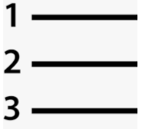
පසුබිම වර්ණ ගැන්වීමට
Shading
අංකන
Numbering
තොරතුරු හා සන්නිවේදන තාක්ෂණය-8 ශ්‍රේණිය
Notes:
Animated rectangles curve up and grow in sequence
(Intermediate)
To reproduce a rectangle on this slide, do the following:
On the Home tab, in the Slides group, click Layout, and then click Blank.
On the Home tab, in the Drawing group, click Shapes, and then under Rectangles click Rounded Diagonal Corner Rectangle (ninth option from the left). On the slide, drag to draw a rounded rectangle.
Drag the yellow diamond adjustment handle to the left to reduce the size of the corner radius.
Select the rounded rectangle. Under Drawing Tools, on the Format tab, in the Size group, do the following:
In the Shape Height box, enter 2.33”.
In the Shape Width box, enter 2.32”.
On the Home tab, in the Drawing group, click the arrow next to Shape Fill, and select No Fill.
On the Home tab, in the Drawing group, click Shape Effects, point to Reflection, under Reflection Variations, select Tight Reflection, touching (first row, first option from the left).
On the Home tab, in the bottom right corner of the Drawing group, click the Format Shape dialog box launcher.
In the Format Shape dialog box, in the left pane click Line Color, and then in the Line Color pane select Solid Line. In the Color list, select More Colors, and then in the Colors dialog box, on the Custom tab, enter values for Red: 137, Green: 227, Blue: 231.
Also in the Format Shape dialog box, in the left pane, click Line Style. In the Line Style pane, in the Width text box, enter 10 pt, and in the Cap type list, select Round.
Also in the Format Shape dialog box, in the left pane, click 3-D Format. In the 3-D Format pane, do the following:
Under Bevel, do the following:
In the Top list, under Bevel, select Circle (first row, first option from the left).
In Top, under Width, enter 10 pt.
In Top, under Height, enter 10 pt.
Under Contour, click the button next to Color, and then under Theme Colors select Olive Green, Accent 3, Lighter 60% (third row, seventh option from the left).
Under Surface, do the following:
In the Material list, under Standard, select Matte (first row, first option from the left).
In the Lighting list, under Neutral, select Soft (first row, third option from the left).
In the Angle box, enter 315°.
Right-click the rounded rectangle and select Edit Text.
Enter text in the text box, select the text, and then on the Home tab, in the Font group, select Gills Sans MT Condensed from the Font list, and select 28 from the Font Size list.
On the Home tab, in the Paragraph group, click Center to center the text.
To reproduce the animation effect on this slide, do the following:
On the Animations tab, in the Animation group, click the More arrow to expand the effects gallery, and then click More Entrance Effects. In the Change Entrance Effect dialog box, under Exciting, click Curve Up.
In the Timing group, do the following:
In the Start list, select With Previous.
In the Duration list, select 00.50.
In the Advanced Animation group, click Add Animation, and under Emphasis, click Grow/Shrink.
In the Advanced Animations group, click Animation Pane. In the Animation Pane, click the arrow at the side of the second (grow/shrink) effect and then click Effect Options.
In the Grow/Shrink dialog box, on the Timing tab, do the following:
In the Start list, select With Previous.
In the Duration list, select 0.5 seconds (Very Fast).
On the Effects tab, do the following:
Click the arrow next to Size, select Custom, enter 5 and then press ENTER.
Click the arrow next to Size, select Vertical.
Select the Auto-reverse check box.
Click OK.
To reproduce a second and third rectangle and the animation, do the following:
On the slide, select the rounded rectangle.
On the Home tab, in the Clipboard group, click the arrow at Copy, and select Duplicate. Position the second rounded rectangle next to the first rounded rectangle. Repeat until there are three rectangles.
In the Animation Pane, in the animation list, press and hold CTRL and select the Curve Up entrance effect and Grow/Shrink emphasis effect for the second rectangle (third and fourth effects in the list). On the Animations tab, in the Timing group, in the Delay text box, enter 0.5.
In the Animation Pane, in the animation list, press and hold CTRL and select the Curve Up entrance effect and Grow/Shrink emphasis effect for the third rectangle (fifth and sixth in the list). Click the arrow next to the effect, select Effect Options, and then in the dialog box, on the Timing tab, in the Delay text box, enter 1.0.
Click the text in each rectangle to change, add or remove it.
To reproduce the background on this slide, do the following:
On the Home tab, in the Drawing group, click Shapes, and then under Rectangles, select Rectangle (first option from the left). On the slide, drag to draw a rectangle.
Select the rectangle. Under Drawing Tools, on the Format tab, in the Size group, do the following:
In the Shape Height text box enter 1.62”.
In the Shape Width text box enter 10”.
Under Drawing Tools, on the Format tab, in the bottom right corner of the Shape Styles group, click the Format Shape dialog box launcher.
In the Format Shape dialog box, in the left pane, click Fill, and in the Fill pane, do the following:
Select Solid fill.
Click the button next to Color, select More Colors, and then in the Colors dialog box, on the Custom tab, enter values for Red: 137, Green: 227, Blue: 231.
Under Transparency, use the slider or box to enter 70%.
Also in the Format Shape dialog box, in the left pane, click Line Color, and in the Line Color pane, select No line.
Position the rectangle on the middle of the slide.
On the Home tab, in the Drawing group, click Shapes, and then under Rectangles, select Round Diagonal Corner Rectangle (ninth option from the left). On the slide, drag to draw a rectangle
Select the round diagonal corner rectangle. Under Drawing Tools, on the Format tab, in the Size group, in the Shape Height text box enter 0.44” and in the Shape Width text box enter 0.44”.
Under Drawing Tools, on the Format tab, in the Shape Styles group, click the Format Shape dialog box launcher.
In the Format Shape dialog box, in the left pane, click Fill, and in the Fill pane, do the following:
Select Solid fill.
Click the button next to Color, under Theme Colors, select White, Background 1, Darker 15% (third row, first option from the left).
In the Transparency, box enter 60%.
Also in the Format Shape dialog box, in the left pane, click Line Color, and in the Line Color pane, select No line.
Select the round diagonal corner rectangle. On the Home tab, in the Clipboard group, click the arrow at Copy, and select Duplicate. Repeat this process until you have a total of seven round diagonal corner rectangles.
On the slide, press and hold CTRL and select the seven round diagonal corner rectangles. On the Home tab, in the Drawing group, click Arrange, and then under Position Objects, point to Align, and do the following:
Click Align Selected Objects.
Click Align Top.
Click Distribute Horizontally.
Right-click the slide background area, and then click Format Background. In the Format Background dialog box, click Fill in the left pane, select Gradient fill in the Fill pane, and then do the following:
In the Type list, select Linear.
Click the button next to Direction, and then click Linear Diagonal – Bottom Right to Top Left (second row, third option from the left).
Under Gradient stops, click Add or Remove until two stops appear on the slider, and customize the gradient stops as follows:
Select Stop 1 on the slider, and then do the following:
In the Position box, enter 50%.
Click the button next to Color, and click White, Background 1 (first row, first option from the left).
Select Stop 2 on the slider, and then do the following:
In the Position box, enter 100%.
Click the button next to Color, and click More Colors. In the Colors dialog box, on the Custom tab, enter values for Red: 204, Green: 244, Blue: 248.

Slide 6
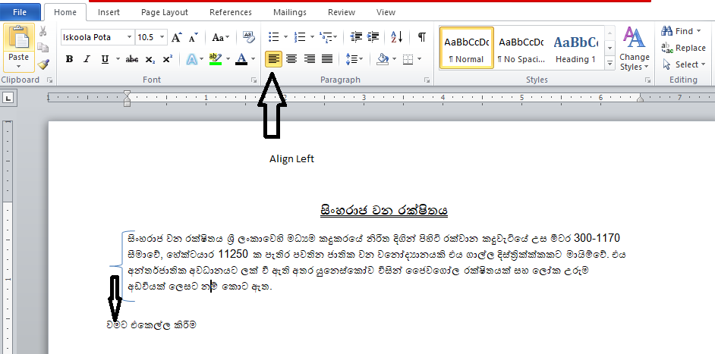
වමට එකෙල්ල කිරීම
Align Left

Slide 7
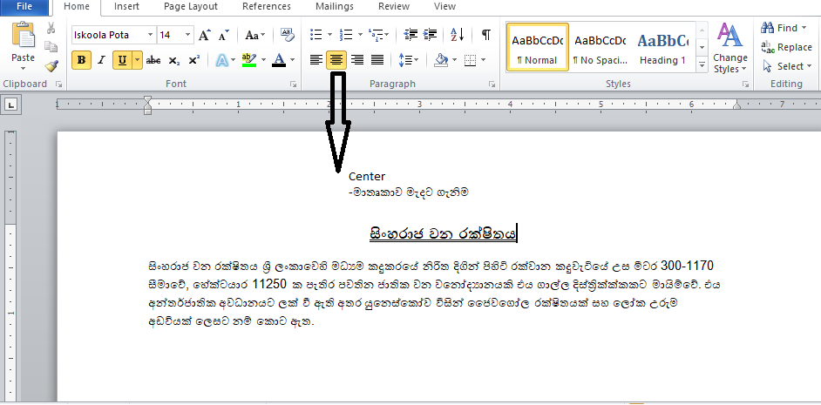
මැදට එකෙල්ල කිරීම
Center

Slide 8
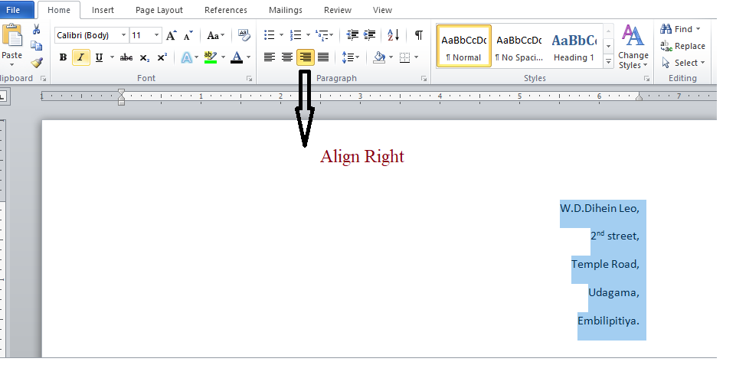
දකුණට එකෙල්ල කිරීම
Align Right

Slide 9
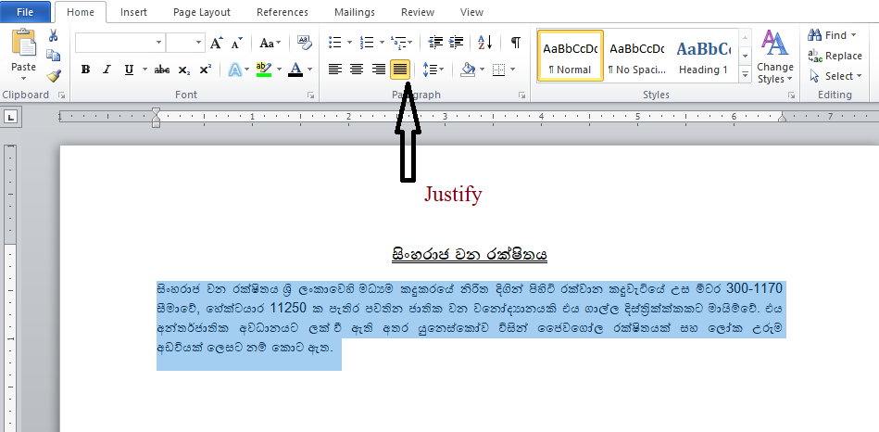
දෙපසට එකෙල්ල කිරීම
Justify

Slide 10
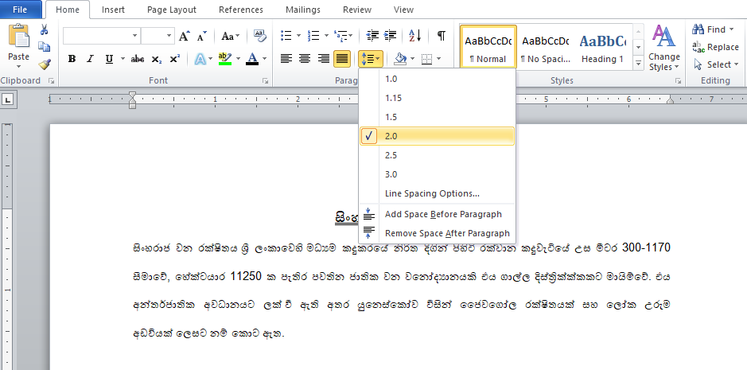
පේළි අතර පරතරය වෙනස් කිරීම
Line Spacing

Slide 11
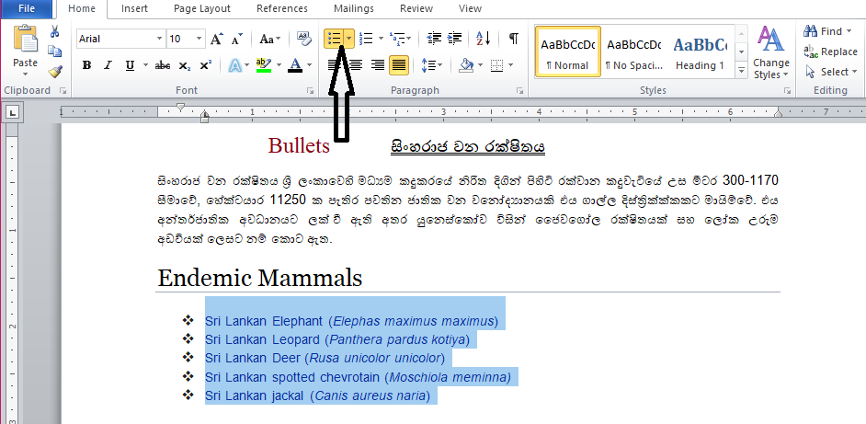
බුලට්
Bullets

Slide 12
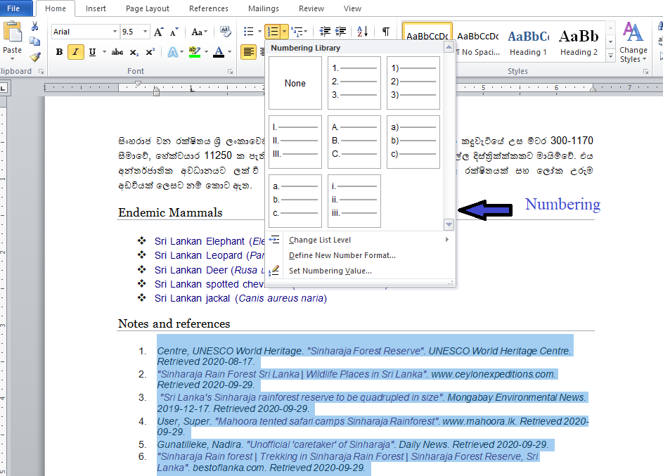
අංකන
Numbering

Slide 13
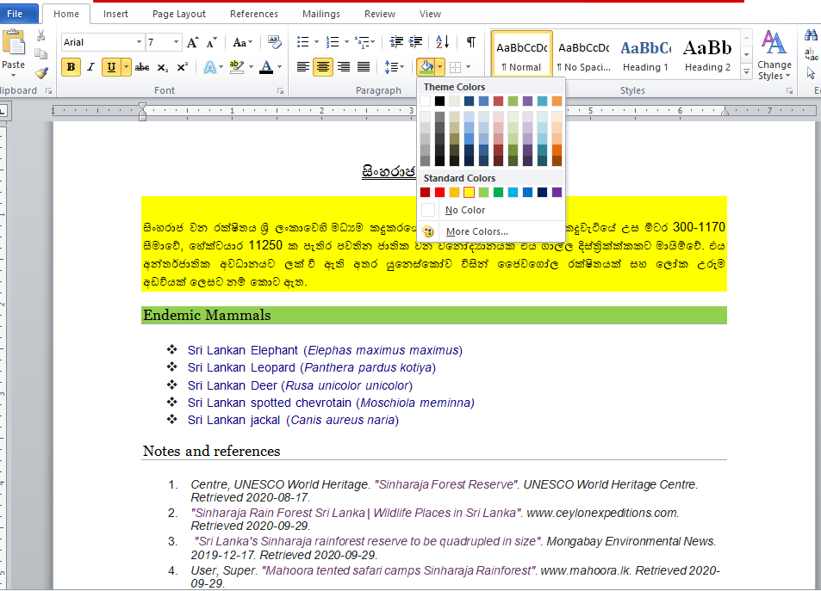
පසුබිම වර්ණ ගැන්වීමට
Shading

Slide 14
පහත පෙන්වා ඇති ලේඛන ප්‍රායෝගිකව සකස් කරන්න.

Slide 16
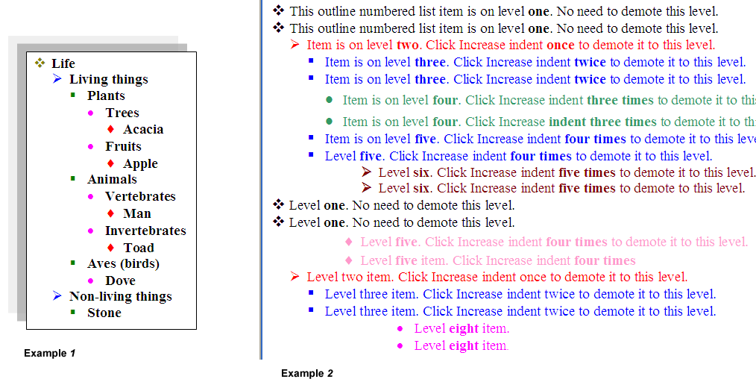
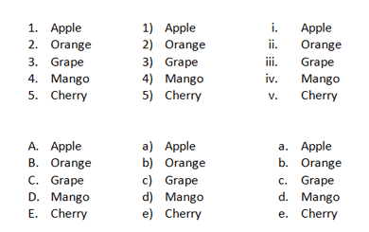

Slide 17
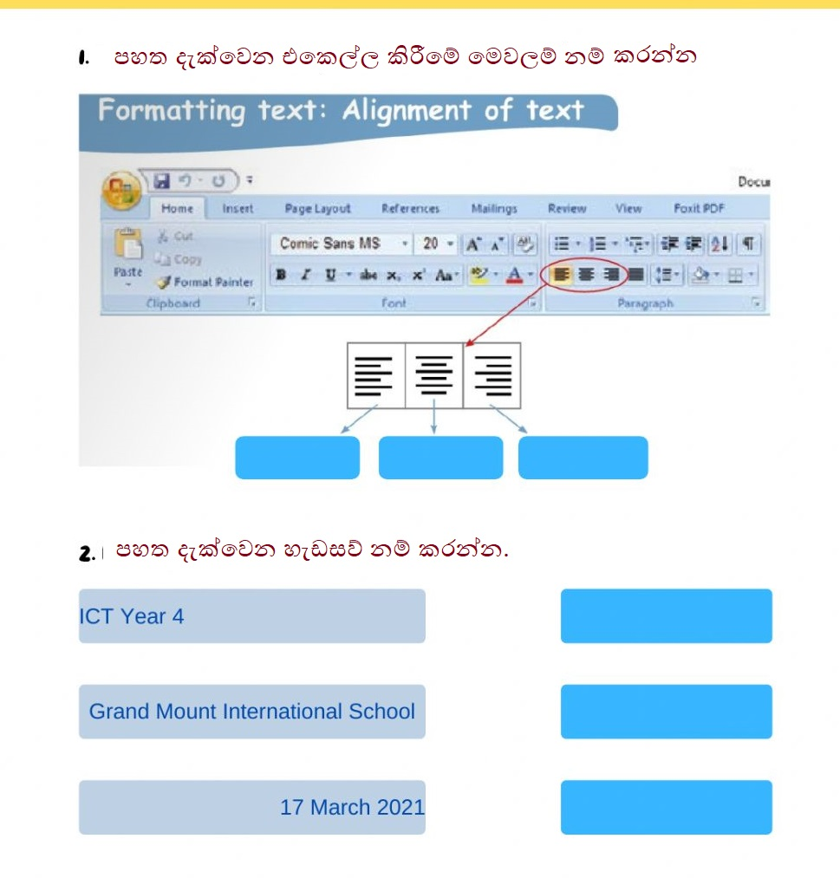
පහත දැක්වෙන ක්‍රියාකාරකම සිදුකරන්න.

Slide 18
ස්තූතියි!!
සැකසීම: P.V.M.G.මාධවි පහලවිතාන
ර/ඇඹි/ඇඹිලිපිටිය මහා විද්‍යාලය
තොරතුරු හා සන්නිවේදන තාක්ෂණය-8 ශ්‍රේණිය

