Slide 1
Unit 9
On Top Of The World.

Slide 2
Vocabulary
Extracurricular actvities – Activities which are done by the students outside the class room.

Slide 3
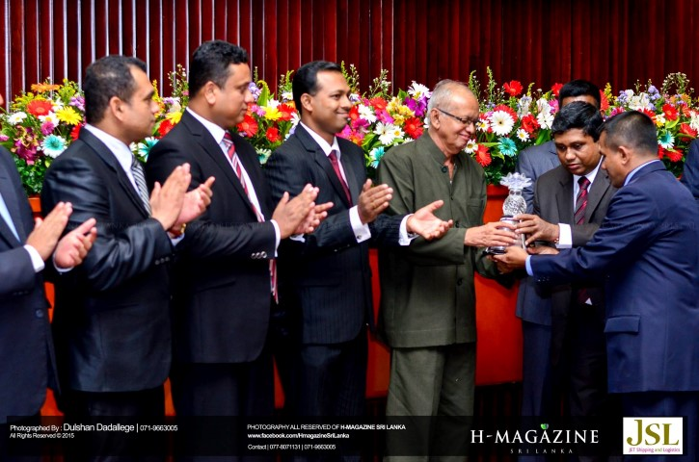
Felicitation – An expression of good wishes ; congratulations

Slide 4
Interview – Conversation where one ask question and the other provide answer.

Slide 5
Cheerful – Very happy / full of hapiness

Slide 6
Confident – Sure about oneself/ yourself

Slide 7
Revise – look again in order to correct or improve

Slide 8
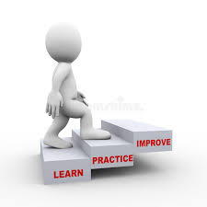
Improve – develop something in a good way

Slide 9
Knowledge – Things what you know

Slide 10
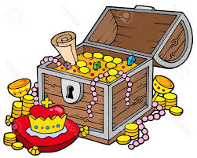
Precious – Great value / high price

Slide 11
Bright – Shining / Good side of something

Slide 12
Read the role play and answer the questions given below
Who got through the GCE (A/L) with three A passes?
Who organized the felicitation ceremony ?
What are the extracurricular activities mentioned in the text?
Write five sentences which show Pasindu was a very good planner.
Find the meanings for given words.
Always Rarely
Usually Never
Often Sometimes

