Slide 1
EASY ENGLISH GRADE 8
ZONAL EDUCATION OFFICE – EMBILIPITIYA
Prepared by –Ms. D.A.N.Lakmali
R/Emb/Mulendiyawala M.V.

Slide 2
UNIT 05 BETWEEN THE MILES
Activity 5.2
Competency Level :- 4.4 Uses affixes to change the word class and the meaning of words.

Slide 3
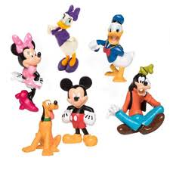
Let’s learn affixes.
Affixes are the groups of letters that can be added to a word to change its meaning or the word class.
They can be divided into two types.
Affixes
Prefixes Suffixes

Slide 4
Now let’s learn suffixes.
Look at this example,
clear + ly
clearly
Base word
suffix
New word
A suffix is a group of letters that can be used at the end of a word.

Slide 5
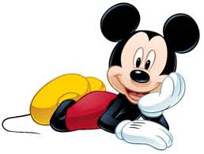
My dear students, remember that the word class and/or the meanings of the word are changed by adding suffixes.
Verb
Adjective
verb | Adjective
care | careless
harm | harmless
cheer | Cheerful / cheerless
colour | Colourful/ colourless
Noun
Adjective
Noun | Adjective
beauty | beautiful
spoon | spoonful

Slide 6
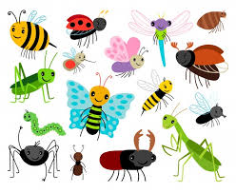
Adjectives
Noun
Adjective | Noun
kind | kindness
happy | happiness
sad | sadness
quick | quickness
neat | neatness

Slide 7
Underline the suffixes.
Watcher
Fortunately
Eatable
Finally
Cheerful
Faster
Careless
Careful
Fearless
kindly

Slide 8
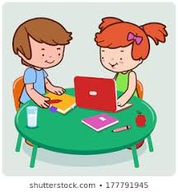
Make a new word using a suffix.
Danger-……………………
Help -……………………….
Home -……………………..
Fear- ……………………………
Child- ………………………….
Green- ……………………………
Oil - …………………………….
Bad - …………………………..

