Slide 1
Grade 8 Unit 9
Prepared by :- Suwani Wathsala
R/Emb Jandura Maha Vidyalaya

Slide 2
The best day of my week is Saturday
Because;
I go shopping with friends
I get up late
I meet my friends
I play video games
I eat a big breakfast
I watch movies
I play cricket
I sleep in the evening
I go swimming
I go to my grand parent's house

Slide 3
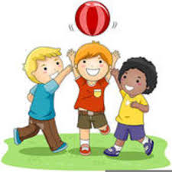
On Saturdays, I always eat a big breakfast.
On Saturdays, I usually get up late.
On Saturdays, I often play cricket.
On Saturdays, I sometimes go to my grand parent’s house.
On Saturdays, I rarely play video games.
On Saturdays, I never go swimming.

Slide 4
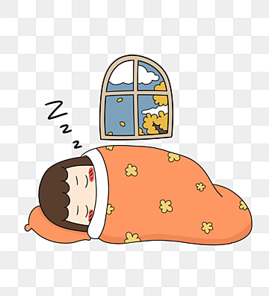
We use adverbs of frequency when we say how often something happens.
On Saturdays, I usually get up late
Adverb
Main verb
Adverbs are usually placed in front of the main verb

Slide 5
100% Always Usually /normally
Often Sometimes
Rarely Never 0%

Slide 6
Put a tick where necessary and construct meaningful sentences
Sentence | Always | Usually | Often | Sometimes | Rarely | Never
Watch news
Get up at 5
Help my mother
Go on trip
Swim in the river
Water the flowers
Ex:-
I always watch news at night

Slide 8
