Slide 1
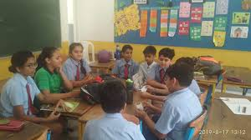
EASY ENGLISH GRADE 8
ZONAL EDUCATION OFFICE- EMBILIPITIYA
Prepared by – Ms. D.A.N.Lakmali
R/Emb/Mulendiyawala M.V.

Slide 2
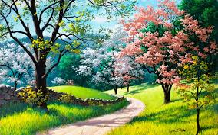
UNIT – 04 MOTHER NATURE
Activity -4.1
Competency Level – Extracts specific information from various types of simple texts.

Slide 3
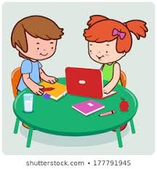
Circle the correct answer.
Who are these two friends ?
Kaveen and Hussain Naveen and Hussain
Are they in the same class?
yes no
3. Why was Kaveen absent?
Because Kaveen was not feeling in the morning.
Because Kaveen went on a trip.
4. Did Hussain get the itinerary?
Yes No

Slide 4
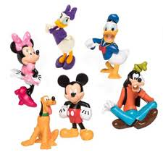
5. At what time will the bus leave?
At 6.30 in the morning At 5.30 in the morning
6. At what time should they be in the school?
At 5 o’ clock At 5.30
7. How should they bring their breakfast?
in a lunch box or wrapped in a banana leaf
only wrapped in a banana leaf
8. Will the lunch be provided?
Yes No

