Slide 1
EASY ENGLISH GRADE 8
ZONAL EDUCATION OFFICE-EMBILIPITIYA
Prepared by – Ms. D.A.N.Lakmali
R/Emb/Mulendiyawala M.V.

Slide 2
UNIT 03 LET’S BE CONSIDERATE
Activity- 3.9
Competency Level – Reads and responds to simple poems.

Slide 3
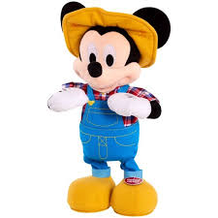
Circle the correct answer.
How many lines are there in this poem?
12
2
2. What is the poem about?
About children
About shadow
3. Find the rhyming words.
Head-bed
Bed- up
4. Which line says that both the writer and the shadow are alike?
5th line
1st line
5. Where was the shadow when the writer woke up in the morning?
In the playground
In bed at home.

