Slide 1
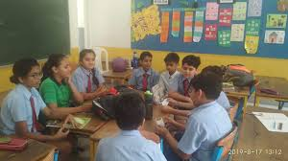
EASY ENGLISH GRADE 08
ZONAL EDUCATION OFFICE - EMBILIPITIYA
Prepared by – Ms. D.A.N.Lakmali
R/Emb /Mulendiyawala M.V.

Slide 2
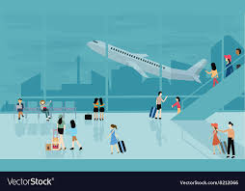
UNIT 05 BETWEEN THE MILES.
Activity 5.3
Competency level – 5.2 Extracts specific information from various types of simple texts

Slide 3
Say whether the following statements are true or false.
Lahiru spent his last vacation with a Japanese pen friend. (……..)
Japanese people are impolite.(……..)
Japanese people are very strong willed.(…….)
Japanese people are not punctual(……….)
Japanese people experience nearly 1500 earthquakes a year.(……)

