Slide 1
EASY ENGLISH GRADE 8
ZONAL EDUCATION OFFICE – EMBILIPITIYA
Prepared by – Ms.D.A.N. Lakmali
R/Emb/Mulendiyawala M.V.

Slide 2
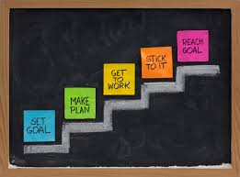
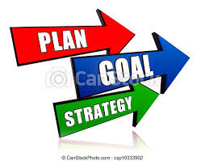
UNIT-01 PLAN THE WORK WORK THE PLAN
Activity – 1.3
Competency level – Uses pronouns appropriately.

Slide 3
Let’s learn pronouns.
Read the following sentences.
01. Sachini is a nurse.
02.She is a nurse.
Here, the word “She” substitutes “Sachini”
But, my dear students, you can not say,
Sachini, she is a nurse.
That means, a pronoun can be used instead of a noun but not in addition to it.

Slide 4
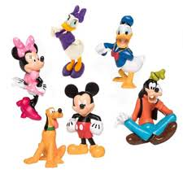
Pronouns are a group of words that are used instead of nouns or noun phrases.
As well as,
Pronouns belong to closed class words . That is, we can not create new pronouns.
They have different forms relating to person, gender and they have singular plural forms.

Slide 5
Let’s see classification of pronouns.
Personal pronouns.
(a) person - first person - I, We
second person – you
third person - he, she, it
(b) Number – singular – I, she ,it, he , you
plural _ we, they , you
Case - subjective – I ,We, You, They, He , She , It
objective - me, us, you, him, it, them
Genitive - my, your, his, its, their
Gender - feminine – she , her
masculine – he, him, his
Neuter/Non personal – it, its

Slide 6
2. Reflexive pronouns (myself, ourselves etc…)
Indefinite/ universal pronouns ( every one, everybody, all, both someone etc…..)
Relative pronouns (who, whom, whose etc………..)
Demonstrative pronouns (this, that etc…)
Reciprocal pronouns (each other, one another )
Interrogative pronouns. (who, whom, what, which etc….)

Slide 7
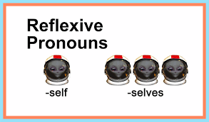
Now, let’s learn reflexive pronouns
These pronouns too are classified according to person, number and gender. As well as they all end in self/selves.
Singular
Subject pronouns | Reflexive pronouns
I | myself
You | yourself
He | himself
She | herself
It | itself

Slide 8
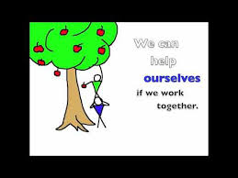
Plural
Subject pronouns | Reflexive pronouns
We | ourselves
You | yourselves
They | themselves

Slide 9
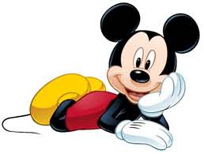
Reflexive pronouns can be used as the object of a verb when the person / thing affected by the action is the same as the person or thing that does action. That is, the subject and the object refer to the same person or thing.
Eg – My mother poured herself a cup of tea.
He fried himself an egg
You have to blame yourself for doing so badly in the term test
Not only that,
Reflexive pronouns are used after nouns or pronouns to emphasize them.
I myself did this activity.
Malith himself saw the thief entering the house.

Slide 10
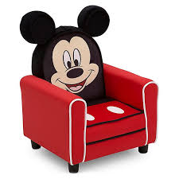
As well as,
Reflexive pronouns are used at the end of a clause to say that someone did something without any help from anyone else. In these sentences “by” can precede the reflexive pronoun
Ex. The boys put up the tent all by themselves.
Nethu cleaned the whole house herself.
Did you make this cake yourself?
Reflexive pronouns are used as prepositional complements where it has the same reference as the subject.
Ex. I am not worried about myself.
You should depend on yourself for this.

Slide 11
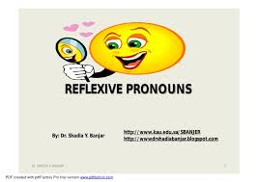
Choose the correct reflexive pronoun from the list given.
Myself, yourself, himself, herself, itself, ourselves, yourselves, themselves
She learnt to play the guitar …………
I ……… do not agree.
Let’s just relax and enjoy ………………
There is no need for the team to peel proud of ………………….
They have bought ………………….. a new car.
He introduced ………………
The doctor said so ……………..
Our cat washes ………………… after every meal.

