Slide 1
ghlk; - 1 ifj;njhopy; Gul;rp

Slide 2
ifj;njhopw; Gul;rp vd;why; vd;d?
kdpjd; jdJ iffshy; nghUs;fis cw;gj;jp nra;tjw;F gjpyhf ,ae;jpuq;fisg; gad;gLj;jp nghUs; cw;gj;jpia Nkw;nfhz;lJld; Rkhu; MW jrhg;j fhyg;gFjpapy; ifj;njhopy; kw;Wk; ifj;njhopy;El;gj; Jiwapy; Vw;gLj;jpa ghupa khw;wNk ifj;njhopy; Gul;rpahFk;.

Slide 3
ifj;njhopw; Gul;rp gpupj;jhdpahtpy; Vw;gl;likf;Fupa fhuzq;fs;
gpupj;jhdpah rpwpa epu;thfkhf fhzg;gl;lik.
%yg;nghUl;fis ,yFthf ngwf;$bajhf ,Ue;jik.
gpupj;jhdpahtpy; fhzg;gl;l murpay; cWjp epiy.
rdj;njhif mjpfupj;jik.
Copaj;ij ,yFthf ngw;Wf;nfhs;s Kbe;jik.
tu;j;jf tsu;r;rp.
gzk;> KjyPL nra;Ak; Mw;wy; nfhz;l nry;te;ju;fs; gyu; fhzg;gl;lik.
tpUj;jpaile;j tq;fpfs; kw;Wk; epjp epWtdq;fs; Njhw;wk; ngw;wik.

Slide 4
ifj;njhopw; Gul;rpapd; tsu;r;rp
gpupj;jhdpahtpy; ifj;njhopw; Gul;rpapd; gpd;tUk; %d;W ifj;njhopy; Jiwfis mbg;gilahff; nfhz;L epfo;e;jJ.
1. nerTf; ifj;njhopy;
2. ,Uk;G cUf;Fk; ifj;njhopy;
3. epyf;fup ifj;njhopy;

Slide 5
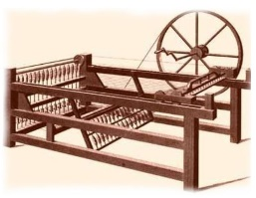
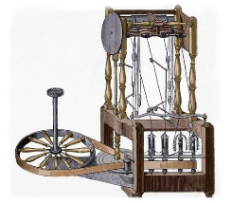
nerTf; ifj;njhopy;

Slide 6
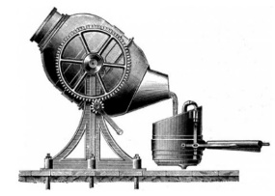
,Uk;G cUf;Fk; ifj;njhopy;

Slide 7
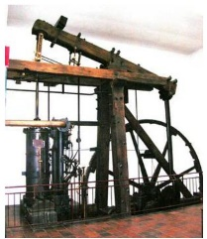
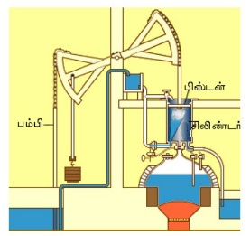
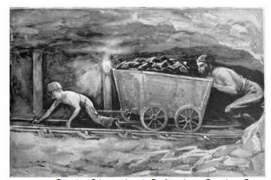
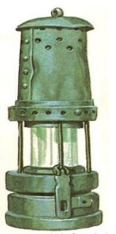
epyf;fup ifj;njhopy;

Slide 8
ifj;njhopw; Gul;rpapd; tsu;r;rp (guty;)
NtW ifj;njhopw; NtW ehLfspy; ifj;njhopw;;
Jiwapyhd tsu;r;rp Gul;rpapd; tsu;r;rp

Slide 9
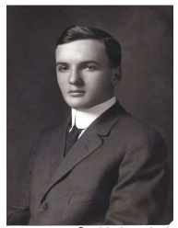
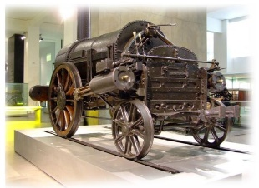
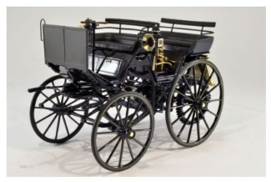
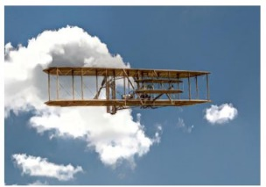
NtW Jiwapyhd guk;gy;
I. Nghf;Ftuj;J Jiw

Slide 10
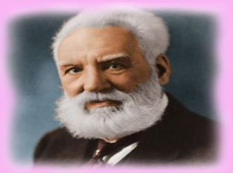
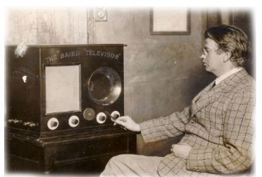
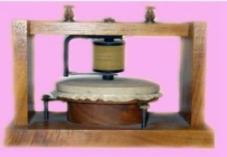
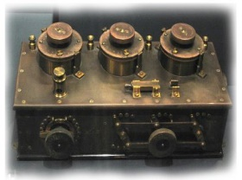
II. njhlu;ghly; Jiw

Slide 11
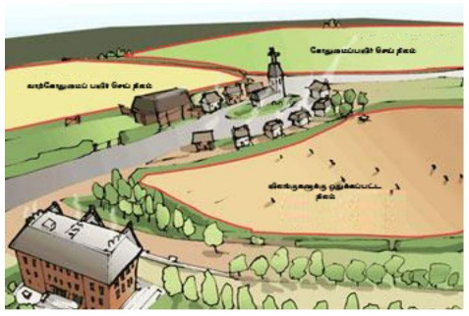
III. tptrhaj; Jiw

Slide 12
NtW ehLfspd; ifj;njhopy;
Gul;rpapd; guty;
gpupj;jhdpah
INuhg;gh fz;lj;ijr; Nru;e;j ehLfs;
(N[u;kdp> gpuhd;];> ngy;[pak;> M];jpupah> `q;Nfup> gpu\;ah)
Mrpahf; fz;lj;ij Nru;e;j ehLfs;
([g;ghd;> ,e;jpah> rPdh> ,yq;if)
Mgpupf;f mnkupf;f fz;lj;ijr; Nru;e;j ehLfs;

Slide 13
ifj;njhopy; Gul;rpapd; tpisTfs;
murpay; Jiwapy; Vw;gLj;jpa khw;wq;fs; | nghUshjhu Jiwapy; Vw;gLj;jpa khw;wq;fs; | r%fj; Jiwapy; Vw;gLj;jpa khw;wq;fs;
Kjyhsp tu;f;fj;jpdUk; ghl;lhsp tu;f;fj;jpdUk; Njhd;wpaik | ifj;njhopy; cw;gj;jpfs; tpuptile;jik | r%f tFg;G NtWghL nfhz;l r%fk; Njhw;wk; ngw;wik
gy;NtW murpay; jj;Jtq;fs; Njhd;wpaik | tzpf tFg;gpdUk; njhopw;rhiy cupikahsu;fshd Kjyhsp tFg;gpdUk; cUthfpaik | njhopyhsu; eyNdhk;gy; Kiw tpUj;jpaile;jik
FbNaw;w ehLfis ifg;gw;Wk; Nghl;b cUthdik | Kjyhspj;Jt nghUshjhu Kiw cUthfpaik | Rw;whly; khrile;jik
njhopyhsu; Mu;g;ghl;lq;fSk; njhopw;rq;fq;fSk; Njhd;wpaik | rk;gsj;ij ek;gp tho;Nthu; Njhw;wk; ngw;wik
 | tq;fp eltbf;iffSk; fhg;GWjp KiwfSk; tpuptile;jik
 | ,ize;j tzpfq;fs; Njhw;wk; ngw;wik
 | Vw;Wkjp ,wf;Fkjp tzpfk; tpuptile;jik

Slide 14
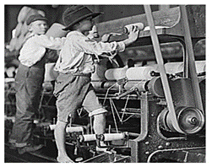
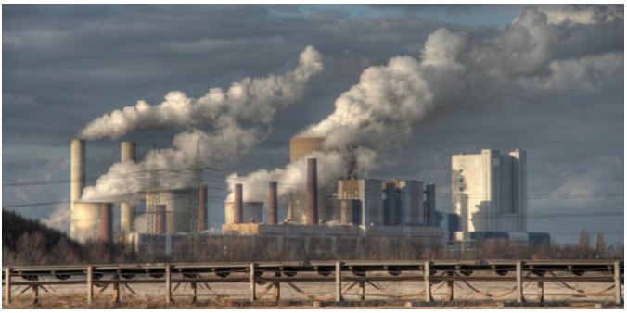

Slide 15
ifj;njhopy; Gul;rp ,yq;ifapy; nry;thf;F nrYj;jpa tpjk;
gpupj;jhdpahtpy; ifj;njhopy; Gul;rp epfo;e;j fhyj;jpy; ,yq;if gpupj;jhdpahtpd; FbNaw;w ehlhf fhzg;gl;lJ. gpupj;jhdpa nry;te;ju;fs; ,yq;if te;J ngUe;Njhl;lj; Jiwapy; KjyPL nra;jyhy; Njitahd ,ae;jpu rhjdq;fs; gpupj;jhdpahtpy; ,Ue;J jUtpf;fg;gl;lik.
,f;fhyj;jpy; ngUe;Njhl;lj;Jiwapy; Vw;gl;l Kf;fpakhd epfo;Tfs;
1804 Mk; Mz;L MSeu; gpul;wpf; Nehu;j; mtu;fshy; Nfhg;gp tpijfis gpupj;njLf;Fk; njhopw;rhiy xd;W Muk;gpf;fg;gl;lJ.
Njapiyf; nfhOe;ij cyu;j;Jjy; Kjy; Vw;Wkjpf;fhfj; jug;gLj;Jjy; vd;gd ,ae;jpu rhjdq;fshNyNa Nkw;nfhs;sg;gl;lik.
,wg;gu; Vw;Wkjpf;fhf jahu;gLj;Jtjw;F ,ae;jpu rhjdq;fs; gad;gLj;jg;gl;lik.
ngUe;Njhl;lq;fs; mikj;jy;> nkf;flk; Kiw 1885 Mk; Mz;by; ,yq;ifapy; mwpKfk; nra;ag;gl;lik.

Slide 16
ifj;njhopy; Gul;rpapdhy; ,yq;ifapy; Vw;gl;l khw;wq;fs;
$ypf;F Ntiy nra;Ak; njhopyhsu; tFg;nghd;W Njhw;wk; ngw;wik.
nry;te;j> fy;tp fw;w> kj;jpaju tFg;nghd;W cUthfpaik.
Vw;Wkjp> ,wf;Fkjp tu;j;jfk; Kd;dpiy ngw;wik.
,yq;ifapYk; tq;fpfs; Muk;gpf;fg;gl;lik.
ngUe;njUf;fSk; Gifapujg; ghijfSk; mikf;fg;gl;lik.
tu;j;jf epiyaq;fs; tsu;r;rpAw;wjhy; efuq;fs; tsu;r;rpAw;wik.
je;jp Kiw mwpKfk; nra;ag;gl;lik

Slide 17
tpdhf;fs;
1. ifj;njhopy; Gul;rp Kjd;Kjyhf Njhd;wpa ehL vJ?
2. ifj;njhopy; Gul;rp INuhg;ghtpy; Vw;gl;likf;Fupa fhuzk; ahJ?
3. epiyik cilikahsu;fshy; tptrhapfspd; rpwpa epyq;fs; xd;W Nru;f;fg;gl;L ngupa tptrha gz;izfs; cUthf;fg;gl;lik
vt;thW miof;fg;gl;lJ?
4. ifj;njhopy; Gul;rp Muk;gj;jpy; gutpa %d;W JiwfSk; vit?
5. ifj;njhopy; Gul;rp gutpa Vida ,U JiwfisAk; Fwpg;gpLf.
6. fp.gp. 1733 Mk; Mz;L N[hd; Nf vd;gtuhy; fz;Lgpbf;fg;gl;l ,ae;jpuk; vt;thW mikf;fg;gl;lJ?
7. fp.gp. 1764 ,y; E}y; E}w;Fk; n[dp ,ae;jpuj;ij fz;Lgpbj;jtu; ahu;?
8. fp.gp. 1769 ,y; upr;rl; Mf;iul;bdhy; fz;Lgpbf;fg;gl;l Mz;L ahJ?
9. fp.gp. 1779 ,y; E}y; E}w;Fk; kpA+y; ,ae;jpuj;ij fz;Lgpbj;jtu; ahu;?
10. epyf;fup %yk; ,Uk;Gj;jhij cUf;Fk; Kiwia fz;Lgpbj;jtu; ahu;?
11. fp.gp. 1784 ,y; Nuhyu; ,ae;jpuk; %yk; gjg;gLj;jg;gl;l ,Uk;ig cw;gj;jp nra;Ak; Kiwia fz;lgpbj;jtu; ahu;?
12. fp.gp.1856 ,y; ,Uk;gpypUe;J fopTfis mfw;wp cUf;F cw;gj;jp nra;Ak; Kiwia fz;Lgpbj;jtu; ahu;?
13. ,Uk;Gj;jhij cUf;ff;$ba kpd;dLg;ig fz;Lgpbj;jtu; ahu;?
14. gpupj;jhdpauhy; epyf;fup gbTfs; ngUkstpy; fhzg;gl;l gpuNjrq;fs; %d;iwj; jUf.

Slide 18
15. Ruq;fj;jpDs; NrUk; ePiu Foha; %yk; ntspNaw;wTk;> Foha; %yk; tspia mDg;gp Ruq;fj;ij
Fsp&l;lf; $ba ePuhtpapdhy; ,aq;ff; $ba ,ae;jpuj;ij fz;Lgpbj;jtu; ahu;?
16. ghJfhg;G tpsf;if fz;Lgpbj;jtu; ahu;?
17. fp.gp. 1811 ,y; nkf;flk; vd;Dk; ngUe;njUf;fs; mikf;Fk; Kiwiaf; fz;Lgpbj;jtu; ahu;?
18. fp.gp. 1814 ,y; ePuhtpapdhy; ,aq;ff; $ba Gifapuj vQ;rpid fz;Lgpbj;jtu; ahu;?
19. fp.gp. 1807 ,y; Giff; glif fz;Lgpbj;jtu; ahu;?
20. fp.gp. 1885 ,y; Nkhl;lhu; tz;bia (fhu;) fz;Lgpbj;jtu; ahu;?
21. fp.gp. 1903 ,y; Mfha tpkhdj;ij fz;Lgpbj;jtu; ahu;?
22. fp.gp. 1844 ,y; je;jp Kiwiaf; fz;Lgpbj;jtu; ahu;?
23. fp.gp. 1895 ,y; thndhypia fz;Lgpbj;jtu; ahu;?
24. njhiyf; fhl;rp ahuhy; fz;Lgpbpf;fg;gl;lJ?
25. Vu; G+l;lg;gl;l Fjpiufs; %yk; tupirahf gapupLk; Kiw ahuhy; mwpKfg;gLj;jg;gl;lJ?
26. Kjyhspj;Jt jj;Jtj;jpy; murpd; jiyaplhf; nfhs;ifia Kd;itj;j nghUspay; mwpQu; ahu;?
27. ,yq;ifapy; gpupj;jhdpau; Ml;rpf; fhyj;jpy; Njhd;wp tsu;r;rpaile;j efuq;fs; %d;W jUf
28. nfhOk;G> fz;b gpujhd tPjp vt; MSeupd; fhyj;jpy; Muk;gpf;fg;gl;lJ?
29. ,yq;ifapy; Gifapuj tPjpfis mikf;Fk; eltbf;iffspy; <Lgl;l MSeu; ahu;?
30. ,yq;ifapy; Kjd;Kjypy; jghy; Kj;jpiu Muk;gpf;fg;gl;l Mz;L vJ?

