Slide 1
,yq;ifapy; gpupj;jhdpaupd;
mjpfhuj;ij epiyehl;Ljy;

Slide 2
mwpKfk;
gpupj;jhdpau;> Nghu;j;Jf;Nfau;> xy;yhe;ju; Nghd;W jhKk; Mrpahtpy; tu;j;jfj;jpy; ,yhgk; <l;l tpUk;gpdu;.
Mq;fpNya tzpf FOnthd;W 1600 brk;gupy; Mq;fpNya fpof;fpe;jpa tu;j;jf fk;gdp Mrpahtpy; tu;j;jfj;jpy; <Lgl;ldu;. mf;fk;gdp KjyhtJ fg;gy; FOtpdu; Rkhj;jpu jPTf;F nrd;W mq;F jkJ tu;j;jf fk;gdpia njhlq;fpdu;. mjd; gpd;du; N`f;fpd;]; jiyikapy; ,d;ndhW fg;gy; FOtpdu; ,e;jpahTf;F te;J mg;Nghija nkhfhya Nguurpd; khkd;duhd [hq;fpupAld; tu;j;jf eltbf;if njhlu;ghf Ngr;Rthu;j;ij elhj;jpdhu;.
17 Mk; E}w;whz;bd; KjypU jrhg;jq;fspy; njd;fpof;F Mrpahtpd; tu;j;jf Mjpf;fj;ij fl;bnaOg;gpf; nfhs;tjpy; Nghu;j;Jf;NfaUf;Fk; xy;yhe;jUf;Fk; ,ilNa Kuz;ghLfs; Vw;gl;ld. ,jd;NghJ Mq;fpNyau; xy;yhe;jUf;F cjtp nra;jdu;. ,t;tpU rhuupd; nghJ vjpupahd Nghu;j;Jf; NfaUf;F vjpuhf NghuhLtjw;F Mq;fpNyau; cjtpia ngw;Wf;nfhz;lhYk; njd;fpof;F Mrpahtpd; thrid jputpaq;fs; tpisAk; jPTfspy; Mq;fpNyaupd; Mjpf;fk; gyg;gLtij xy;yhe;ju; tpUk;gtpy;iy ,jdhy; 1623 Mk; Mz;by; `k;Ngha;dh jPtpypUe;J Nfhl;il xd;iw jhf;fpa xy;yhe;ju; mq;fpUe;j Mq;fpNya gFjpapdiu nfhd;Wtpl;ldu;. mjw;F vjpuhf xy;yhe;ju; kPJ gjpy; jhf;Fjy; nra;a Mq;fpNyaupd; gyk; ,Uf;ftpy;iy njd;fpof;F Mrpah gpuNjrq;fspy; ,Ue;J Mq;fpNyau; nrd;W tpl;ldu;. mjd; gpd;du; mtu;fs; ,e;jpah kPJ jkJ G+uz ftdj;ij nrYj;jpajhf njupfpwJ.
17 Mk; E}w;whz;bd; Kd;gFjpapy; nrd;id> gk;gha;> fy;fj;jh> cl;gl gy;gpuNjrq;fspy;
tu;j;jf epiyaq;fis Muk;gpf;f Kbahjjhf ,Ue;jJ.
Nffhiy tyaf; fy;tpf; fhupahya r%ftpQ;Qhdg; gpupT

Slide 3
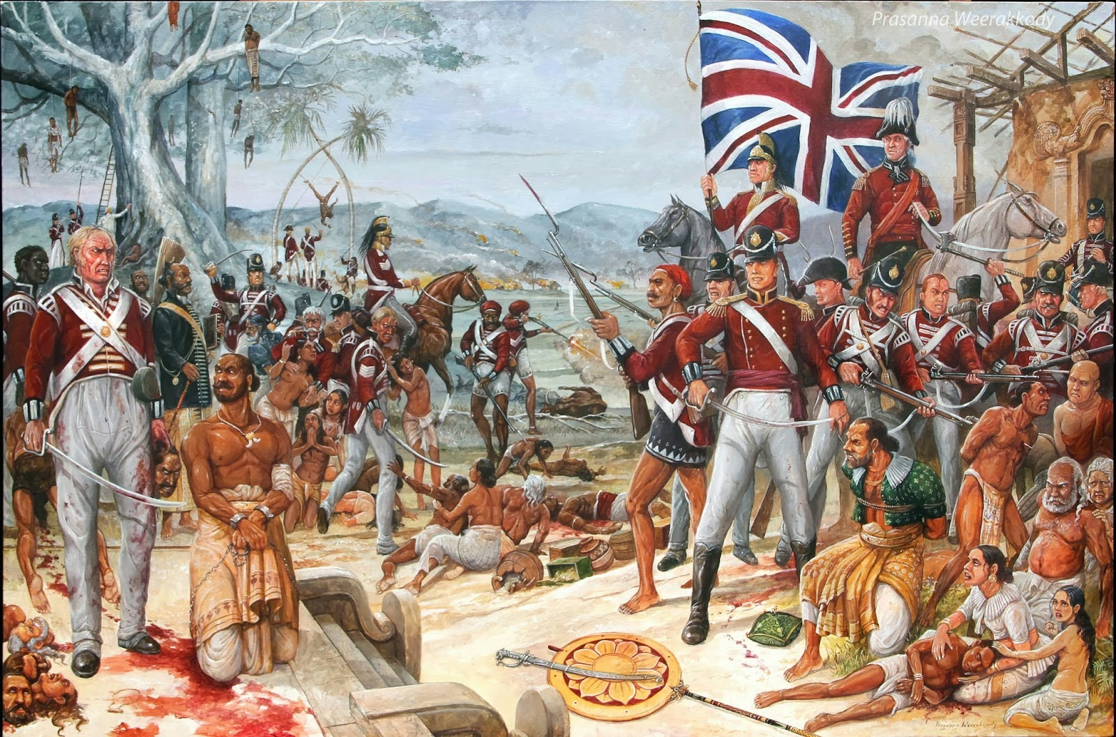
Nffhiy tyaf; fy;tpf; fhupahya r%ftpQ;Qhdg; gpupT

Slide 4
,yq;if kPJ gpupj;jhdpaupd; ftdk; <u;f;fg;gly;
ftdk; <u;f;fg;gl;ljd; fhuzk;
01& ,yq;ifapd; miktplk;
02& ,yq;ifapd; fWth cl;gl ngWkjp tha;e;j tuj;jf nghUl;fs; fpilf;fg;ngw;wik
,yq;if ,e;jpahtpw;F mUfpy; ,Ue;jikahYk; tq;fsh tpupFlh cl;gl ,e;jpahit #oTs;s fly; gpuNjrq;fspy; flw;gil Mjpf;fj;ij kj;jpa epiyakhf ,Uj;jy;
,e;jpahtpd; fpof;F Nkw;F eltbf;iffis ,yq;ifapypUe;J epu;tfpf;f $bajhf ,Ue;jik.
jpUNfhzkiy JiwKfk; tq;fhy tpupFlhit Nehf;fp mike;jpUe;jik.
,e;jpahtpd; fpof;F fiuNahu gFjpapd; Mq;fpy flw;gil gyj;jpid ghJfhj;jf; nfhs;s.
tlfpof;F gUt kioapd; NghJ fg;gy;fis eq;$ukplf;$ba ,lkhf ,Uj;jy;
jpUNfhzkiy ,aw;if JiwKfkhf ,Uj;jy;
,yq;ifapd; fWthtpw;F Kjyplk; toq;fg;gl;lJ.
fpof;F ehLfSld; nfhz;l tu;j;jfj;jpy; Nghu;j;Jf;Nfau; kw;Wk; xy;yhe;jUf;F mjpfshthd tUkhdk; fpilj;jJ.
kpsF> Kj;J> khzpf;fk; kw;Wk; ahidj;je;jk; Nghd;w ngUkjp tha;e;j nghUl;fis ngwf;$bajhf ,Ue;jik
Nffhiy tyaf; fy;tpf; fhupahya r%ftpQ;Qhdg; gpupT

Slide 5
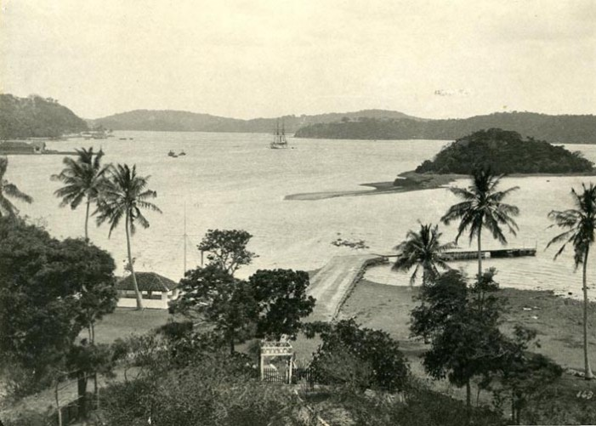
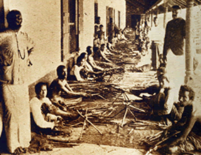
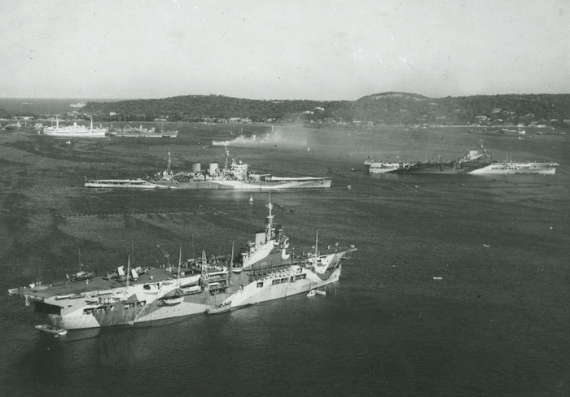
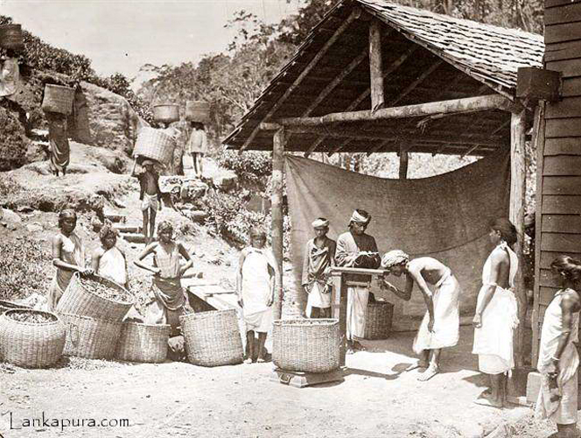
jpUNfhzkiy JiwKfk;
tpahghug; nghUl;fs;
Nffhiy tyaf; fy;tpf; fhupahya r%ftpQ;Qhdg; gpupT

Slide 6
Mq;fpNyaUf;Fk; fz;b ,uhr;rpaj;jpw;Fk;
,ilapyhd njhlu;G
1762 ,y; N[hd; igg]pd; tUif
1782 ,y; `pA nghapl;bd; uh[rpq;fd; kd;did re;jpj;jy;
1795 nuhgl; md;W}]; uh[rpq;fd; kd;did re;jpj;jy
gpupj;jhdpau;mjpfhuj;ij epiyehl;Ljy;
,yq;ifia gpupj;jhdpaupd; FbNaw;w ehlhf;Ftjpy; Kidg;ghf njupAk; re;ju;g;gq;fs; %d;W MFk;.
1796 ,y;Mq;fpNya fpof;fpe;jpa tu;j;jf fk;gdp fiuNahu gpuNjrq;fspy; jkJ Mjpf;fj;ij epiyepWj;jpf; nfhs;Sjy;.
1802 Mk; Mz;by; mJtiu Mq;fpNya fpof;fpe;jpa tu;j;jff; fk;gdpapd; epUthfj;jpypUe;J ,e;ehl;bd; fiuNahug; gpuNjrq;fis Kbf;Fupa FbNaw;w ehlhf;fg;gLjy;.
1815 ,y; fz;b ,uhr;rpaj;ij ifg;gw;Wjy;.
Nffhiy tyaf; fy;tpf; fhupahya r%ftpQ;Qhdg; gpupT

Slide 7
1797 Mz;by; Mq;fpy fpof;fpe;jpa tu;j;jf fk;gdpf;F vjpuhf
vOe;j Kuz;ghLfs;
fpof;fpe;jpa tu;j;jf fk;gdp elhj;jpr; nrd;w ngd;id Ml;rpahsp Ml;rpapdhy; ntWg;Gw;w fiuNahu kf;fspilNa Kuz;ghLfs; Vw;gl;ld.
,t;thW fiuNahu kf;fspd; gpur;rpidfis tprhupj;J mjw;fhd jPu;itg; ngw;Wf; nfhLg;gjw;F gpupNfbau; n[duy; B kpA+ud; jiyikapy; Mizf;FO xd;W epakpf;fg;gl;lJ. ,J kA+ud; Mizf;FO vdg;gl;lJ>
kpA+ud; Mizf;FOtpd; rpghu;Rfs;
tup t#ypg;gjpy; <Lgl;bUe;j nrd;id cj;jpNahfj;ju;fs; jpUg;gp mDg;gp itf;fg;gl;L mtu;fSf;F gjpyhf RNjr cj;jpNahfj;ju;fis <LgLj;jy;
njq;Ftup cl;gl Gjpa tupfis ePf;Fjy;.
gzj;jpd; %yk; tup mwtpLtjw;Fg; gjpyhf nghUl;fis Nrfupj;jy;.
tup t#ypg;gjw;Fk; ePiu toq;Ftjw;Fk; ntt;Ntwhd cj;jpNahfj;ju;fis epakpj;jy;
xy;yhe;jupd; ePjpkd;w Kiwapid kPz;Lk; jhgpj;jy;.
Nffhiy tyaf; fy;tpf; fhupahya r%ftpQ;Qhdg; gpupT

Slide 8
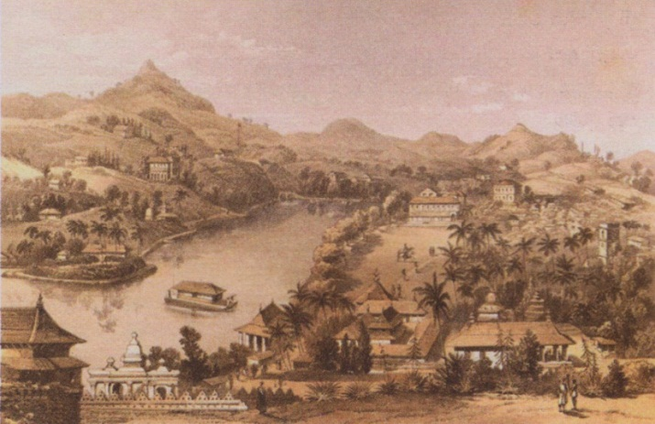
Mq;fpNyau; fz;b ,uhr;rpaj;ij ifg;gw;Wtjw;fhd
fhuzpfs;
fz;bapy; Rje;jpukhd munrhd;W ,Ug;gJ gpupj;jhdpaupd; Ml;rpf;F Mgj;jhdJ vd fUjpaik.
Mq;fpNyaUf;F vjpuhf fiuNahu fpsu;r;rpfSf;F fz;b kd;dd; MjuT toq;fpaik.
fiuNahu gpuNjr kf;fs; fz;b kd;did jkJ kd;ddhf fUjpaik.
nfhOk;gpy; ,Ue;J jpUNfhzkiyf;fhd fly;top Nghf;Ftuj;jpw;F mjpf nryT Mq;fpNyaUf;F Vw;gl;lik. ,jdhy; nfhOk;gpy; ,Ue;J fz;bapD}lhf jpUNfhzkiyf;F Nghf;Ftuj;J mDkjp toq;f fz;b murd; kWj;jik.
Nffhiy tyaf; fy;tpf; fhupahya r%ftpQ;Qhdg; gpupT

Slide 9
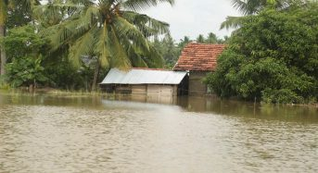
1803 gpwlupf; Nehj; MSeupd; gilnaLg;G
Nkf;Nlhtypd; J}Jg;gazk; vjpu;ghuhj gyid milahjjhy; Mseu; Nehf; 1803 Mk; Mz;L fz;bf;F gilnaLj;jy;.
1803 fz;b gilnaLg;gpy; gpupj;jhdpau;
Njhy;tpaile;jikf;fhd fhuzq;fs;
kiyaf kf;fspd; Aj;j je;jpuq;fs;
kiyaf ,uhr;rpaj;jpd; jdpj;Jtk;
fz;ba kf;fspd; nfhupy;yh Nghu; Kiw
rpq;fstu;fspd; xw;Wik
kf;fs; muDf;F tpRthrkhf ,Ue;jik
Mq;fpNya gilfis efu;j;Jtjpy; Vw;gl;l rpukq;fs;
gUt fhyj;jpy; Vw;gl;l njhlu; kioapdhy; nts;sg;nghUf;F Vw;gl;lik
Nffhiy tyaf; fy;tpf; fhupahya r%ftpQ;Qhdg; gpupT

Slide 10
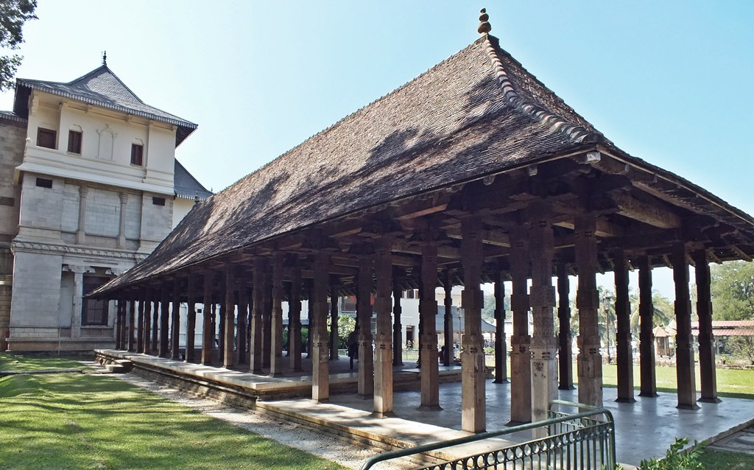
1815 fz;b cld;gbf;if
1815 khu;r; 02 Mk; jpfjp fz;b mur rig (kfy;kLt) kz;lgj;jpy; Mq;fpNya fl;rp rhu;ghf MSeu; gpnusd;wpf; fz;b kf;fs; rhu;ghf mjd; gpujhdpfSf;F ,ilNa xg;ge;jk; xd;W ifrhj;jplg;gl;lJ. mJ fz;b cld;gbf;if vdg;gl;lJ.
Nffhiy tyaf; fy;tpf; fhupahya r%ftpQ;Qhdg; gpupT

Slide 11
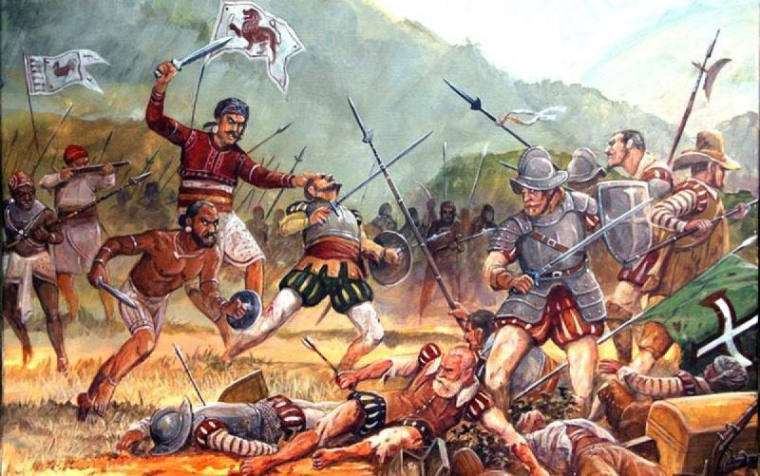
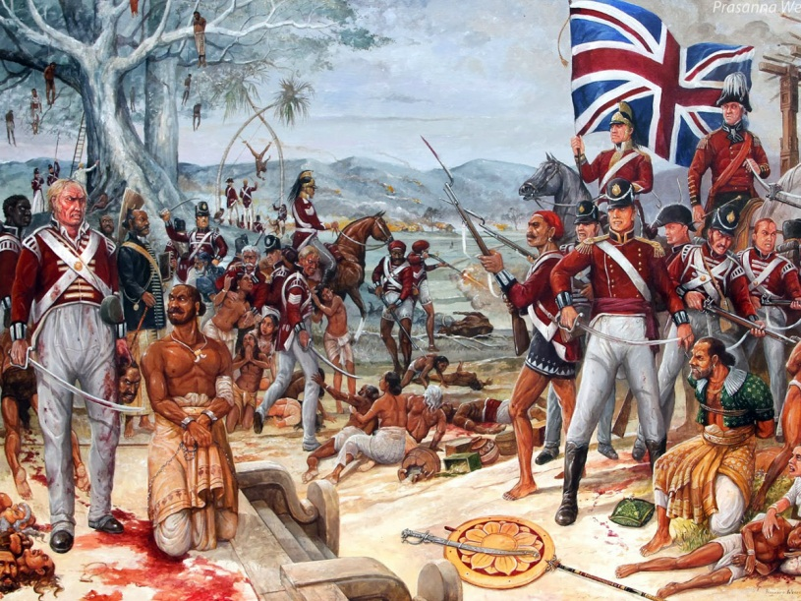
me;epau; Ml;rpf;F vjpuhf
01. 1818 Rje;jpug; Nghuhl;lk; (Cth nty;y];])
1817 bnrk;gu; khjj;jpy; ,Ue;J 1818 xf;Nlhgu; khjk; tiu fz;bapy; epytpa Mq;fpNya Ml;rpf;F vjpuhf kf;fs; Majjhupfshf fpsu;e;J vOe;jik KjyhtJ Rje;jpu Nghuhl;lk; vdg;gLfpd;wJ.
Nffhiy tyaf; fy;tpf; fhupahya r%ftpQ;Qhdg; gpupT

Slide 12
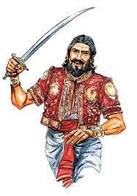
1818 Rje;jpug; Nghuhl;lj;jpw;fhd fhuzq;fs;
kf;fs; Rje;jpuj;ij ,oe;jikAk; murd; ,y;yhik gw;wpa kdNtjid
kiyehl;L gpuG tu;f;fj;Jf;F Vw;gl;l jhf;fk;
rka> fyhrhu> ghJfhg;G njhlu;ghd gpur;rpidfs; cUthfpaik.
1818 Rje;jpu Nghuhl;lk;
Nghuhl;lk; tpupT gl;l gpuNjrq;fs;
igfka kdhlfhda
Jk;giw
N`thn`l;l
`hup];gj;Jt
khj;jis
rg;gpufKt
Etufyhtpa
nfg;gbnghy jprht
nfh`{FGNu uNluhy
kLfy;Ny jprhit
gpypkjyht jprhit
G+l;lht ul;Nluhy
fpA+Nynfju nkhn`l;lhy
jk;gtpd;d jprhit
jpk;Gyhd jprhit
fynfju nkhn`l;lhy
Nffhiy tyaf; fy;tpf; fhupahya r%ftpQ;Qhdg; gpupT

Slide 13
1818 Rje;jpu Nghuhl;lj;jpd; tpisTfs;
Mq;fpNyaupd; fLikahd mlf;F Kiwf;F fz;bau;fs; ,yf;fhfpaik
nfg;gb nghy> kLfy;Ny MfpNahu; ,uh[ JNuhfpfs; vd epidj;J Nghfk;giuapy; jiyia ntl;b kuz jz;lid toq;fs;.
Vida jiytu;fs; ehL flj;jg;gl;L nrhj;jf;fs; gwpKjy; nra;ag;gl;lJ.
Mq;fpNyaUf;F Mjuthf nkhy;ypnfhl kw;Wk; vf;neypnfhl nraw;gl;likahy; mtu;fSf;F tug;gpurhjq;fs;> epyq;fs;> nrhj;Jf;fs; toq;fg;gl;ld.
Nffhiy tyaf; fy;tpf; fhupahya r%ftpQ;Qhdg; gpupT

Slide 14
02. 1848 ,uz;lhk; Rje;jpug; Nghuhl;lk;
Nghuhl;lj;jpw;F toptFj;j fhuzpfs;
1833 eilKiwf;F te;j Nfhy;GW}f; rPu;jpUj;jj;jpd; jhf;fk; kw;Wk; MSeu; nlhupd;ld; 1848 tupf; nfhs;if.
Gjpa tupf; nfhs;if(
Kj;jpiu tup
Jg;ghf;fp tup
Ms; tup
eha; tup
tz;b kw;Wk; fg;gy; tup
Nffhiy tyaf; fy;tpf; fhupahya r%ftpQ;Qhdg; gpupT

Slide 15
1848 Rje;jpug; Nghuhl;lk;
tpupT gl;l gpuNjrq;fs;
Nghuhl;l jiytu;fs;
khj;jis(gpujhd ,lk;)
fz;b
FUehfiy
thupanghy
tPuGud; mg;G
nfhq;fhNynfhl gz;lh
`q;Fuq;nfj bfpupuhy
jpNa];
fl`nghy `pkp
Nffhiy tyaf; fy;tpf; fhupahya r%ftpQ;Qhdg; gpupT

Slide 16
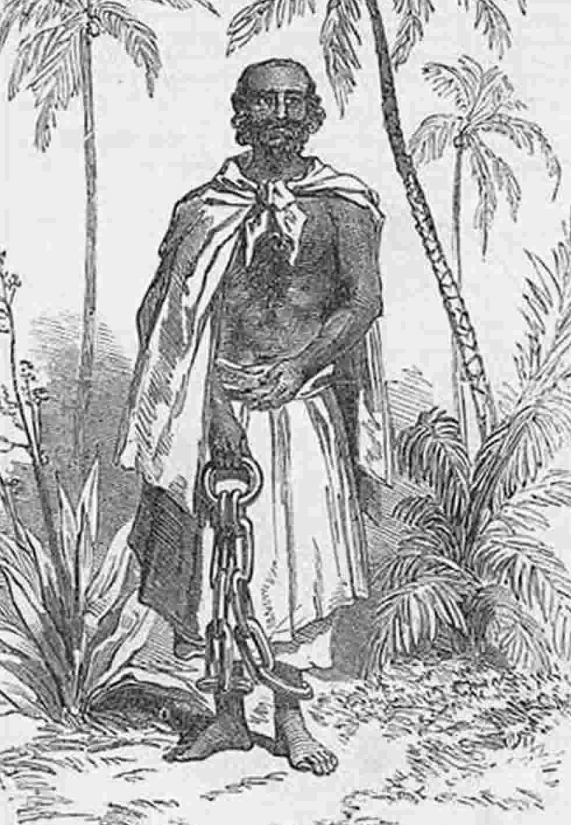
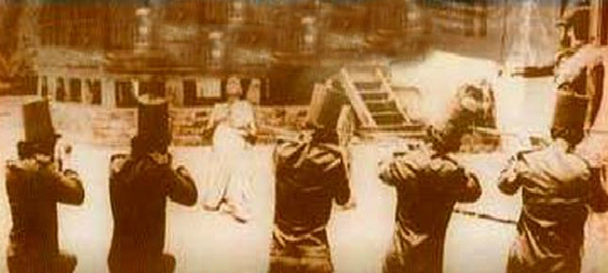
Nffhiy tyaf; fy;tpf; fhupahya r%ftpQ;Qhdg; gpupT

Slide 17
,yq;ifapy; gpupj;jhdpa Ml;rp
1' gpupj;jhdpa tu;j;jfu;fspdhy; cUthf;fg;gl;l tu;j;jff; fk;gdp vJ?
2' tpy;ypak; N`hf;fpd]; jiyikapy; fg;gy; Fotpdu; ,e;jpahtpw;F
te;jNghJ mq;fpUe;j Kfyha Nguuru; ahu;?
3' gpupj;jhdpa fpof;fpe;jpa tu;j;jf kj;jpa epiyak; vJ?
4' gpuhd;rpdhy; cUthf;fg;gl;l tu;j;jf kj;jpa epiyak; vJ?
5' njd;fpof;F Mrpahtpy; tu;j;jf mjpfhuj;ij epiyehl;Ltjw;fhf
Kuz;gl;l <u ,dj;jtu;fisAk; jUf.
6' gpupj;jhdpau; ,yq;if kPJ ftdk; nrYj;jpaikf;fhd fhuzq;fs;
,uz;L jUf.
7' gpupj;jhdpau; jpUNfhzkiy JiwKfj;jpd; kPJ ftdk;
nrYj;jpaikf;fhd fhuzq;fs; ,uz;L jUf.
8' tq;fhs tpupFlhit Nehf;fp mike;jpUe;j ,e;ehl;L JiwKfk; vJ?
9' ,yq;ifapy; ,Ue;J xy;yhe;jiu tpul;Ltjw;F = uh[rpq;f kd;dd;
J}Jtiu mDg;gpaJ vt; ,dj;jtUf;F vjpuhf?
Nffhiy tyaf; fy;tpf; fhupahya r%ftpQ;Qhdg; gpupT

Slide 18
10' kiyehl;Lf;F tUif je;j J}Jtu;fisAk; mtu;fs; tUif je;j
Mz;LfisAk; KiwNa jUf.
11' N[hd; igg]; ,e;ehl;Lf;F tUif jUk; NghJ kiyehl;il Ml;rp
nra;j kd;dd; ahu;?
12' Mq;fpNyau; ,yq;if fiuNahu gpuNjrq;fis ifg;gw;wpa Mz;L
vJ?
13' ,yq;if fiuNahug; gpuNjrk; gpupj;jhdp fhyzpj;Jtj;Jf;F cl;gl;l
Mz;L vJ?
14' fp.gp 1795 Mz;Ltiu ,e;ehl;il Mz;l xy;yhe;j MSeu; ahu;?
15' xy;yhe;ju; trkpUe;j vj; JiwKfk; FWfpa fhyj;jpw;Fs; gpupj;jhdpau;
trkhdJ?
16' Mq;fpNyauhy; ,e;ehl;Lf;F mwpKfg;gLj;jg;gl;l tup tiffs; vit?
17' Mq;fpy tu;j;jf fk;gdpf;F vjpuhf fiuNahu gpuNjrq;fspy; fpsu;r;rp
Vw;gl;l Mz;L vJ?
Nffhiy tyaf; fy;tpf; fhupahya r%ftpQ;Qhdg; gpupT

Slide 19
18' fiuNahug; gFjpfspy; Vw;gl;l fpsu;r;rp njhlu;ghf Muha;e;J Njitahd
rPu; jpUj;jq;fis nra;tjw;fhf kWrPuikg;G gupe;Jiu nraq;tjw;F
tUif je;j Mizahsu; ahu;?
19' kpA+ud; Mizf;FOtpd; gupe;Jiuas; vit?
20' ,yq;if fiuNahug; gpuNjrq;fis epu;tfpg;gjw;fhf tUif je;j
Kjy; gpupj;jhdpa MSeu; ahu;?
21' ,ul;ilahl;rp ,lk; ngw;w Mz;L vJ?
22' 1800 Mk; Mz;by; MSeu; gpul;wpf; Nehj; kiyehl;Lf;F mDg;gp
itj;j Mizf;FOtpd; jiytu; ahu;?
23' ,yq;ifapd; Mq;fpNyaupd; gpujhd Ml;rp ikak; vJ?
24' Mq;fpNyaupd; ,e;ehl;L flw;gil ikak; vJ?
25' nkf;Nlhtd; jsgjp jiyikapy; Mq;fpNyauhy; kiyehL
Mf;fpukpf;fg;gl;l Mz;L vJ?
26' 1803 Mk; Mz;L kiyehl;L Mf;fpukpg;gpd; NghJ Mq;fpNyau;
vjpu;Nehf;fpa gpur;rpidfis Fwpg;gpLf.
Nffhiy tyaf; fy;tpf; fhupahya r%ftpQ;Qhdg; gpupT

Slide 20
27' ve;j gpujhdpapd; Ntz;LNfhSf;F ,dq;f fd;drhkp = tpf;fpuk rpq;f
vd;w ngaupy; Kb#bdhd;?
28' MSeu; Nehj;ij mLj;J ,e;ehl;il epu;tfpf;f tUif je;j MSeu;
ahu;?
29' Njhk]; nkapz;l; uz;l; kiy ehl;bid vjpu; fhyj;jpy;
Mf;fpukpg;gjw;fhf je;jpu cghakhf nraw;gLtjw;fhf cgNahfpj;j
mur cj;jpNahfj;ju; ahu;?
30' N[hd; nlhapdp rpq;fs; nkhopia fw;Wf; nfhz;lJ ahUila
jiyikapd; fPo;?
31' kiyehl;L uh[jhdp njhlu;ghd ,ufrpaq;fis njupe;J nfhs;tjw;fhf
Mq;fpNyau; gad;gLj;jpf; nfhz;l efu;fisf; Fwpg;gpLf.
32' = tpf;fpuk uh[rpq;f kd;ddhy; kuz jz;lidf;F cs;shd mjpfhup
ahu;?
33. = tpf;fpuk uh[rpq;f kd;dd; ,Wjp rpy tUlq;fspy; Kd;ndLj;Jr;
nrd;w ed;ikahd tplaq;fisf; Fwpg;gpLf.
34' = tpf;fpuk uh[rpq;f kd;dDf;Fk; kiyehl;L kf;fSf;FkpilNa
,ilntsp Vw;gl;ljw;fhd fhuzq;fis jUf.
Nffhiy tyaf; fy;tpf; fhupahya r%ftpQ;Qhdg; gpupT

Slide 21
35' kiyehl;L cld;gbf;if ifr;rhj;jplg;gl;l tUlk; ,lk; kw;Wk; jpfjp
vd;gtw;iw Fwpg;gpLf.
36' kiyehl;L cld;gbf;ifapy; Kjy; %d;W mj;jpahaq;fspy;
Fwpg;gplg;gl;l tplaq;fs; vit?
37' kiyehl;L cld;gbf;ifapy; ehd;fhtJ mj;jpahaj;jpy; Fwpg;gplg;gl;l
tplak; vJ?
38' 1818 Mk; Mz;L Rje;jpug; Nghuhl;lk; vd;gJ ahJ?
39' 1818 Mk; Mz;L Rje;jpug; Nghuhl;lk ,lk; ngw;wikf;f;fhd fhuzq;fs;
ahJ?
40' Ct nty;y];] gpuNjrq;fspy; gpujk gpujhdpfs; gyk; ,oe;J
tpuf;jpaila fhuzkhf mike;j tplak; ahJ?
41' Mq;fpNyau; Ml;rpia Fwpj;J kiyehl;ltUf;F ntWg;G fhzg;gl;lNjhL
rpq;fhrdj;Jf;F cupikahsu; vd nty;y];] gFjpapy; Njhd;wpa
jiytu; ahu;?
42' gpujk gpujhdpfSs; kiyehl;L Nghuhl;lj;jpy; ,ize;J nfhs;shj
gpujhdpfis Fwpg;gpLf.
43' jupR epyr;rl;lk; vd;why; vd;d?
44' 1818 Mk; Mz;L Rje;jpug; Nghuhl;lj;Jf;F jiyiktfpj;j egu;fis
Fwpg;gpLf.
Nffhiy tyaf; fy;tpf; fhupahya r%ftpQ;Qhdg; gpupT

