Slide 1
ghlk; - 5
gpupj;jhdpaupd; fPo; ,yq;ifapd; r%f khw;wk;

Slide 2
gpupj;jhdpau; ,yq;ifapy; FbNaw;w ehlhfpa fhyj;jpy; ePz;lfhykhf epytp te;j murpay;> r%f> nghUshjhu KiwfSk; fyhrhu mikg;G KiwfSk; ,e;ehl;by; fhzg;gl;ld. 1948 Mk; Mz;L ,yq;if Rje;jpuk; milAk; NghJ ahg;G Kiwfspy; ghupa khw;wq;fs; Vw;gl;bUe;jd. 1815 Mk; Mz;L tiu ,yq;ifapy; epytpa kuG top murhl;rp Kiw gpupj;jhdpau; Ml;rpf; fhyj;jpy; ghuhSkd;w Ml;rp Kiwahf gupdhk tsu;r;rp mile;jJ. Gjpa epu;thff; fhyg;gFjpapy; ,yq;ifapy; r%f> nghUshjhu> fyhrhu Kiwfspy; Vw;gl;l khw;wq;fs; njhlu;ghf fz;lwpNthk;.

Slide 3
nghUshjhu khw;wk;
Njtek;gpa jp];] kd;dd; fhyk; Kjy; ngsj;j rkaj;ij mbg;gilahf nfhz;l r%f nghUshjhu fl;likg;G> 19Mk; E}w;whz;by; Nghu;j;jf;Nfau; tUifAld; khw;wk; fz;lJ.
Nghu;j;Jf;Nfau; tu;j;jfj;jpy; mjpf ftdk; nrYj;jpaikahy; gpuNjr tptrhak; Kf;fpaj;Jtj;jpid ,oe;jJ.
,yq;ifapy; xy;yhe;ju; Ml;rpapd; fiuNahu gpuNjrj;jpy; Vw;Wkjpia Nehf;fhff; nfhz;L fWth> kpsF vd;gd gapuplg;gl;ld.
xy;yhe;ju; rpW ifj;njhopy;fis Muk;gpj;jJ kl;Lkd;wp ciog;Gf;Ff; $ypiaAk; toq;fpdu;. ,jdhy; rk;gsj;jpw;F Ntiy nra;Ak; njhopyhsu; tFg;nghd;W cUthdJ.
gpupj;jhdpau; 1815 ,y; fz;biaf; ifg;gw;wpa gpd; nghUshjhuj;jpy; gy;NtW khw;wq;fs; Kd;itg;gjd; %yk; tUkhdj;ij mjpfupf;f Nfhy;GW}f; Mizf;FOtpd; %yk; gy rpghupRfis Kd;itj;jJ.

Slide 4
Nfhy;GW}f; Mizf;FOtpd; nghUshjhu
rPu;j;jpUj;jq;fs;
murpd; Kyjdg; gpur;rpidiaj; jPu;f;f jdpahu;j;; Jiw KjyPl;il Cf;Ftpj;jJ.
jdpahu; Kaw;rpahz;ikapd; tsu;r;rpf;Fj; jilahf ,Ue;j murpd; fhzp tpw;gidf; nfhs;ifia nraw;gLj;jpaik.
fl;lha ,uh[fhupa Kiwia ePf;fp ngUe;Njhl;l Jiwf;fhd ciog;igg; ngWtjw;fhd re;ju;g;gq;fis Vw;gLj;jpaik.
murpd; tu;j;jf VfNghf cupik jdpahu; Jiwapd; tsu;r;rpf;Fj; jilahf mike;jjhy; fWth> cg;G tu;j;jfj;jpy; murpd; VfNghf cupikia ePf;fpaik.
tup mwtpLk; Vy tpw;gid Kiwia ePf;fp vy;yhf; fhzpfspypUe;Jk; rktsT tupiag; gzkhf mwtpl rpghu;R nra;ag;gl;lJ.
ehl;bd; Nrkpg;G tq;fp xd;iw Muk;gpj;J rhjhuz tl;bf; fld; toq;Fk; jpl;lk;
mwpKfg;gLj;jg;gl;lJ.

Slide 5
ngUe;Njhl;lj; Jiwapd; mgptpUj;jp
,yq;ifapy; 1833 Nfhy;GW}f; Mizf;FOtpd; rpghupRfs; eilKiwg;gLj;jg;gl;l gpd;dNu ,e;ehl;by; ghupa nghUshjhu khw;wk; xd;wpw;fhd mbj;jsk; ,lg;gl;lJ.
cs; ehl;L ntspehl;L Kaw;rpahsu;fis Cf;Ftpj;J Vw;Wkjp %yk; mjpfk; ,yhgk; ngwf;$ba ngUe;Njhl;l gapu;r;nra;ifia mgptpUj;jp nra;tjw;F eltbf;if vLf;fg;gl;lJ.

Slide 6
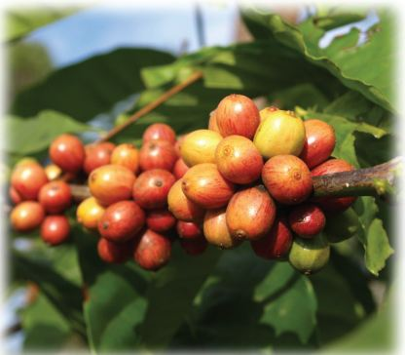
Nfhg;gpg; gapu;r; nra;if

Slide 7
,yq;ifapy; xy;yhe;ju; Ml;rp fhyj;jpy; rpwpa mstpy; Muk;gpf;fg;gl;l Nfhg;gpg; gapu;r; nra;if gpupjhdpauhl;rp fhyj;jpy; ngUe;Njhl;lg; gapuhf khwpaJ.
Nfhg;gpr; nra;ifapd; tpUj;jpf;F nry;thf;F nrYj;jpa fhuzpfs;
1833 Mk; Mz;L Nfhy;GW}f; rPu;j;jpUj;jq;fspd; gpd;du; ntspehl;L KjyPl;lhsu;fs; mjpfstpy; Nfhg;gpj; Njhl;lq;fspy; KjyPL nra;jdu;.
INuhg;gpa re;ijapy; Nfhg;gpf;fhd Nfs;tp mjpfupj;jik.
Nfhg;gpr; nra;if %yk; mjpf ,yhgk; mila Kbe;jik.
njd;dpe;jpa Copau;fs; %yk; Fiwe;j $ypf;F ciog;G ngw;Wf; nfhs;sg;gl;lik.

Slide 8
Nfhg;gp gapuplg;gl;l gpuNjrq;fs;
Jk;giw> fk;gis> Nguhnjdpa> khj;jis> gJis
Nfhg;gpr; nra;ifia ghjpj;j fhuzpfs;
1844 ,y; gpupj;jhdpah gpd;gw;wpa Rje;jpu tu;j;jf nfhs;if fhuzkhf ,yq;if Nfhg;gpf;F Vw;gl;l fLk; Nghl;b.
1848 ,y; Vw;gl;l cyf nghUshjhu tPo;r;rp.
1869 ,y; Nfhg;gp gapUf;F Vw;gl;l ,iy ntspwy; Neha; (n`kpypah nt];lf;];)

Slide 9
rpq;Nfhdh kw;Wk; nfhf;Nfh
Nfhg;gpf;fhd khw;Wg; gapuhf rpq;Nfhdh gapu;r; nra;if Muk;gpf;fg;gl;lJk; mJ Ftpidd; kUe;Jf;fhd %ypifg; gapuhf tpsq;fpaikahy; mJTk; ntw;wpaspf;ftpy;iy.
Nfhg;gpr; nra;iff;F gjpyPlhf Muk;gpf;fg;gl;l nfhf;Nfh gapUk; epoy; Njitg;gl;ljhy; khj;jis khtl;lj;jpy; khj;jpuk; gapu;nra;if gz;zf;$ba fhuzkhf ntw;wpaspf;ftpy;iy.

Slide 10
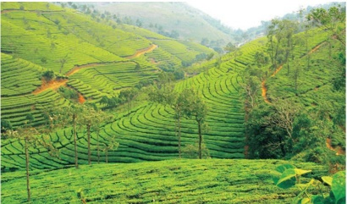
Njapiyg; gapu;r;; nra;if

Slide 11
Njapiy tpUj;jpapy; gq;fspg;Gr; nra;j fhuzpfs;
,yq;ifj; Njapiyf;F cyf re;ijapy; rpwe;j Nfs;tp epytpaik.
cyu; tyak; jtpu ,yq;ifapd; Vida gpuNjrq;fs; Njapiyg; gapu; nra;iff;F cfe;jjhf fhzg;gl;lik.
etPd ,ae;jpu rhjdq;fSldhd njhopw;rhiyfs; fhuzkhf jukhd Njapiy cw;gj;jp nra;ag;gl;lik.
ngUe; njUf;fs;> Gifapuj tPjpfs; fhuzkhf Nghf;Ftuj;J trjpfs; NkYk; Kd;Ndw;wk; mile;jik.
njd;dpe;jpahtpy; ,Ue;J njhopyhsu;fs; nfhz;Ltug;gl;L Fiwe;j $ypf;F ciog;G ngw;Wf; nfhs;sg;gl;lik.

Slide 12
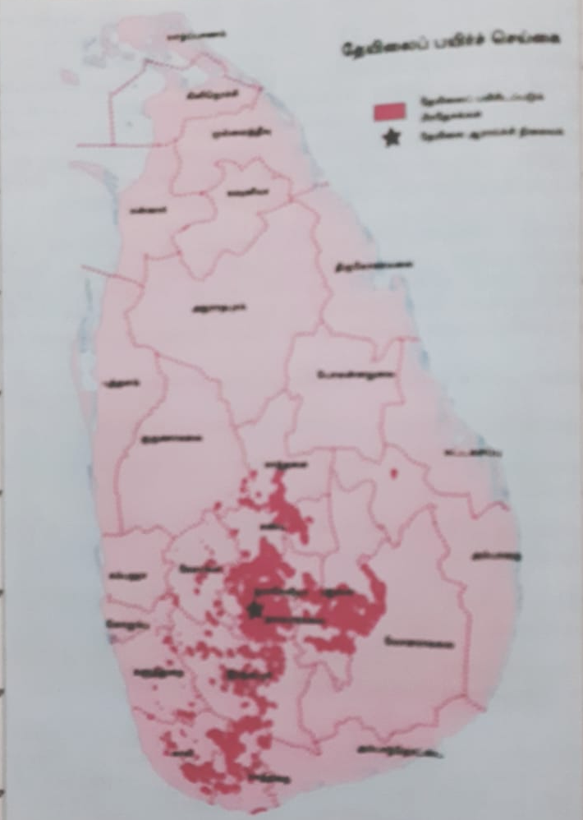
Njapiy gapuplg;gLk; ,lq;fs;

Slide 13
njq;F gapu;r; nra;if
njd;id gz;ilfhyk; Kjy; ,yq;ifapy;
gapuplg;gl;L tUk; tPl;Lj;Njhl;lg; gapuhFk;.
njd;idg; gapu;r; nra;ifapy; Kf;fpaj;Jtk; ngw;w gpuNjrq;fs;
FUehfy;> rpyhgk;> fk;g`h

Slide 14
njq;F gapu;r; nra;ag;gLk; ,lq;fs;

Slide 15
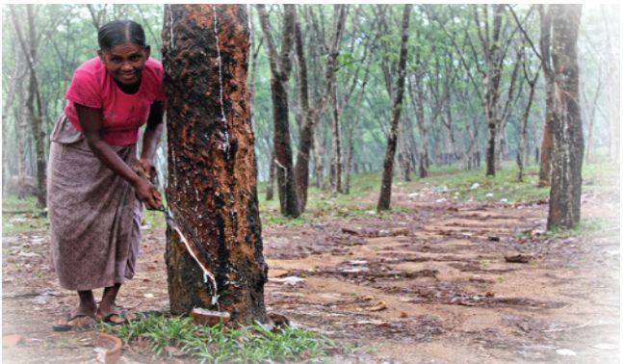
,wg;gu; gapu;r; nra;if
1877 Mk; Mz;lstpy; ,yq;ifapy; ,wg;gu; gapu;r; nra;if Muk;gpf;fg;gl;lJ.

Slide 16
,wg;gu; gapu;r; nra;ag;gLk; ,lq;fs;

Slide 17
,wg;gu; gapu;r; nra;if Ntfkhf guty; miltjpy; nry;thf;F nrYj;jpa fhuzpfs;
20 Mk; E}w;whz;bd; Muk;gj;jpy; Vw;gl;l Nkhl;lhu; thfd ifj;njhopypd; mgptpUj;jp.
,yq;iff;F nghUj;jkhd ,wg;gu; ,dj;ij mwpe;J mjw;F nghWj;jkhd njhopy;El;g Kiwfs; gad;gLj;jg;gl;lik.
Njapiyapd; tpiy jw;fhypfkhf tPo;r;rpaile;jik.

Slide 18
r%f khw;wq;fs;
kj;jpa ju tFg;gpdupd; Njhw;wk;.
njhopyhsu; tFg;gpdu; Njhw;wk; ngwy;.

Slide 19
fyhrhu khw;wk;
Nfhy;GW}f; rPu;jpUj;jj;jhy; Mq;fpy; nkhop %ykhd Nkiyj;Nja fy;tp %yk; ,e;ehl;by; Nkiyj;Nja fyhrhuk; guTtjw;F top Vw;gl;lJ.
cau; fy;tpf;fhf ntspehL nrd;W te;jtu;fshYk; Nkiyj;Nja fyhrhuk; gutpaJ.
19 Mk; E}w;whz;by; ngUe;Njhl;lj; Jiwapd; tsu;r;rp fhuzkhf INuhg;gpau; ngUkstpy; ,yq;iff;F tUif je;jikahy; Nkiyj; Nja fyhrhuk; gutpaJ.

Slide 20
gpupjhdpau; Ml;rpapd; fhuzkhf
Vw;gl;l tpisTfs;
mD$yq;fs; | gpujp$yq;fs;
1. ru;tNjr nkhopahd Mq;fpy nkhopawpT ehl;bDs; gutpaJ | 1. Nkiyj; Njrj;jpd; fyhrhuk; guty; fhuzkhf cs;ehl;L fyhrhuk; ghuk;gupak; rPuoptpw;F cl;gl;lik.
2. Nghf;Ftuj;J kw;Wk; njhlu;ghly;Jiw tsu;r;rpaile;jik | 2. kJghdg; ghtid ehnlq;fpYk; gutpaik.
3. Vw;Wkjpf;fhd ngUe;Njhl;lg; gapu;fs; mwpKfk; nra;jik | 3. fhzp cupikaw;w kf;fs; $l;lk; cUthfpaik.
4. ifj;njhopy; Gul;rpapd; ed;ikfis ,yq;ifAk; ngw;wik | 4. kuG uPjpahd jd;dpiwTg; nghUshjhuk; tPo;r;rpaile;jJld; Njrpa uPjpapyhd mwpTk; Mw;wYk; kOq;fbf;fg;gl;lik.
5. ghuhSkd;w Ml;rp Kiw | 5. fk;rgh vDk; gad;kpf;f fpuhk rigfs; ,y;yhnjhope;jik.

Slide 21
tpdhf;fs;
1. Kw;fhyj;jpy; muru;fSf;F Nritahw;wpa mjpfhupfspd; tho;thjhuj;jpw;F toq;fg;gl;l epyq;fs; vt;thW miof;fg;gl;ld.
2. Nfhg;gpf;fhd Vw;Wkjp tupia Fiwj;j MSeu; ahu;?
3. Nfhg;gpg; gapu; nra;ifia ghjpj;j cldb fhuzp ahJ?
4. 1867 ,y; ngUe;Njhl;l cw;gj;jpahsu; rq;fk; Njapiy njhlu;ghd tpguq;fis ngw xU FOit mDg;gpa ,lk;.
5. Yy;fe;Ju Njhl;lj;jpy; Kjd;Kjy; Njapiyr; nra;ifia Nkw;nfhz;ltu; ahu;?
6. njq;F Kf;Nfhz tyaj;jpy; ,lk; ngWk; %d;W ,lq;fSk; vit?
7. Njapiy Muha;r;rp epiyak; fhzg;gLk; ,lk; vJ?
8. njd;id Muha;r;rp epiyak; fhzg;gLk; ,lk; vJ?
9. ,wg;gu; Muha;r;rp epiyak; fhzg;gLk; ,lk; vJ?
10. efu;Gwj; njhopyhsu;fspd; njhopw;rq;f eltbf;iffSf;fhf ghLgl;l jiytu; ahu;?
11. Njhl;lj; njhopyhsu;fspd; Nghuhl;lq;fSf;Fj; jiyik tfpj;j jiytu; ahu;?
12. 1922 ,y; ,yq;if njhopyhsu; rq;fj;ij Muk;gpj;j jiytu; ahu;?

Slide 22
1). I. gpd;tUk; epfo;TfNshL njhlu;Gila Mz;Lfis KiwNa Fwpg;gpLf.
A. fz;b ,uhr;rpak; gpupjhdpauhy; ifg;gw;wg;gl;lik.
B. Nfhy;GW}f; rPu;jpUj;jk; mwpKfkhfpaJ
C. ,yq;if Rje;jpuk; mile;jik (3 Gs;spfs;)
II. Nfhy;GW}f; Mizf;FOtpdhy; ,yq;ifapd; ngUe;Njhl;lj;Jiw tpUj;jpf;F
Kd;itf;fg;gl;l rPu;jpUj;jq;fs; ,uz;ilf; Fwpg;gpLf. (4 Gs;spfs;)
III. Nfhg;gpr; nra;ifapd; tpUj;jpapy; nry;thf;F ntYj;jpa fhuzpfs; ,ua;ilf;
Fwpg;gpl;L tpsf;Ff. (5 Gs;spfs;)
IV. Njapiy gapu; nra;ifapd; tpUj;jpapy; gq;fspg;Gr; nra;j fhuzpfs; %d;iw
Fwpg;gpl;L tpsf;Ff. (6 Gs;spfs;)
2). I. njd;id gapuplg;gLk; khtl;lq;fs; %d;W jUf. (3 Gs;spfs;)
II. Mq;fpNyauhy; ,yq;ifapy; mwpKfk; nra;ag;gl;l tu;j;jfg; gapu;fs;
ehd;F jUf. (4 Gs;spfs;)
III. Nfhy;GW}f; rPu;jpUj;jj;jhy; Vw;gl;l r%f khw;wq;fs; ,uz;ilf; Fwpg;gpl;L
tpsf;Ff. (5 Gs;spfs;)
IV. gpupj;jhdpau; Ml;rpapdhy; Vw;gl;l mD$yq;fs; ,uz;ilAk; gpujp$yk;
xd;iwAk; Fwpg;gpl;L %d;iwAk; tpsf;Ff. (6 Gs;spfs;)

