Slide 1
ghlk; - 6
,yq;if Rje;jpuk;
miljy;

Slide 2
,g;ghlj;jpd; %yk; vjpu;ghu;f;fg;gLk; fw;wy; Nju;r;rpfs;
1947 Nrhy;gup ahg;G
1972 Kjyhk; FbauR ahg;G
1978 ,uz;lhk; FbauR ahg;G
Rje;jpuj;Jf;Fg; gpd;duhd mgptpUj;jp eltbf;iffs;

Slide 3
Nrhy;gup rPu;j;jpUj;jKk; Rje;jpuk;
1. ehl;bd; cs;ehl;L epu;thfk; njhlu;ghd $ba mjpfhuk; fpilf;Fk; tpjkhd rPu;j;jpUj;jj;ij mDkjpj;jy;.
2. ,yq;ifapd; KjyhtJ ghuhSkd;wj; Nju;jy; 1947 ,y; elhj;j KbntLj;jik.
3. D.S. Nrdhehaf;f mtu;fs; If;fpa Njrpa fl;rpia cUthf;fpaik.
4. KjyhtJ ghuhSkd;wj; Nju;jypy; 1947 ,y; elhj;jg;gl;lik.
5. ,yq;ifapd; KjyhtJ gpujkuhd D.S. Nrdhehaf;f mtu;fshy; ghJfhg;G ntspehl;L tptfhuk; njhlu;ghd ,U xg;ge;jq;fs; ifrhj;jplg;gl;lJ.

Slide 4
1947 Nrhy;gup ahg;G

Slide 5
gpujhd epWtdq;fs;
MSeu; ehafk;
gpujkUk; mikr;ruitAk;
ghuhSkd;wk;
ePjpkd;wk;

Slide 6
,yq;ifapd; fl;rp Kiwik
fl;rp Kiwik
,U fl;rp Kiw
gy fl;rp Kiw
gpupj;jhdpah gpuhd;];> N[u;kd;
If;fpa mnkupf;fh ,e;jpah> ,yq;if

Slide 7
1956 nghJj; Nju;jYk; r%f khw;wKk;
1956 Mk; Mz;L ghuhSkd;wj; Nju;jy; ,yq;if murpay; tuyhw;wpy; xU jpUg;G KidahFk;.
,yq;if Rje;jpuk; mile;jJ Kjy; epu;thf eltbf;iffis Kd;ndLj;Jr; nrd;w If;fpa Njrpa fl;rpf;F tpNuhjkhf murpay; fl;rpfSk; RNal;ir FOf;fSk; ,ize;J nghJ[d If;fpa Kd;ddpia Njhw;Wtpj;jhu;fs;.

Slide 8
1956 nghJj; Nju;jypy; Nghl;bapl;l fl;rpfs;
S.W.R.D. gz;lhuehaf;fhtpd; - ,yq;if Rje;jpuf; fl;rp
gpypg; Fztu;jd - Gul;rpfu rkrkh[f; fl;rp
tp[ahde;j j`ehaf;f - ghrh nguKd
I.M.R.A. tPupanfhy;y kw;Wk; RNal;ir Ntl;ghsu;fs; ,ize;J – kf;fs; [f;fpa Kd;ddp

Slide 9
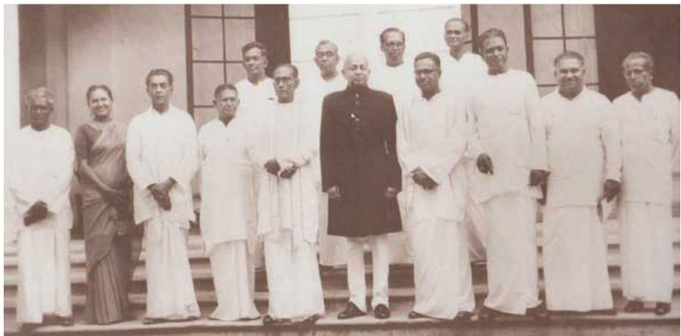

Slide 10
1972
Kjyhk; FbauR ahg;G

Slide 11
1972 Mk; Mz;L ahg;gpy; ,yq;if gupG+uz Rje;jpu Fbaurhf khwpaJ
1947 – yq;fh
1972 - = yq;fh

Slide 12
1972 Mk; Mz;L FbauR ahg;gpd;
mbg;gil mk;rq;fs;
,Jtiu yq;fh vdg;gl;l ,e; ehL ,jd; gpwF
= yq;fh vdg;ngauhy; miof;fg;gl;lJ.
gpupjhdpa NguuRld; nfhz;bUe;j murpay; uPjpahd njhlu;Gfis KbTf;F nfhz;Ltuy;.
,yq;if xd;Wgl;l FbaurhFjy;.
kdpj cupikfisg; ghJfhj;jy;.

Slide 13
mbg;gil Rje;jpuk;
rl;lj;ij mDgtpj;jy;> nraw;gLj;jy;> ghJfhg;G ngwy;> midtUf;Fk; nghJthdjhFk;.
rl;l%ykhf md;wp egu; xUtupd; capUf;Fk; Rje;jpuj;jpw;Fk; ghJfhg;gpw;Fk; ,ilQ;ry; tpistpf;ff; $lhJ.
midtUf;Fk; rpe;jpf;Fk; Rje;jpuj;jpw;Fk; kdrhl;rpapd;gb elf;Fk; rka Rje;jpuj;jpw;Fk; cupikAz;L.
Fbkf;fSf;F mikjpahf xd;W $Ltjw;Fk; jkJ fUj;ij ntspg;gLj;jtjw;Fk; Rje;jpuk; cz;L.

Slide 14
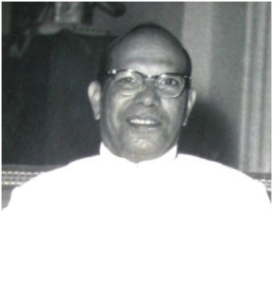
[dhjpgjp gjtp
Nrhy;gup ahg;gpd;gb ,Ue;j MSeu; ehafk; gjtpf;F gjpyhf Gjpa murpay; ahg;gpd;gb ngausT mjpfhuKila [dhjpgjp gjtp mwpKfg;gLj;jg;gl;lJ.

Slide 15
Njrpa muRg; Nguit
1972 Mk; ahg;gpw;F Kd;du; ghuhSkd;wk; vd;W miof;fg;gl;l rl;l rigf;F gjpyhf Njrpa muRg; Nguit cUthf;fg;gl;lJ. ,jd; gjtpf;fhyk; 6 tUlq;fs; MFk;.
gpujkupd; jiyikapyhd mikr;ruit
,t; murpay; ahg;gpd; gb epiwNtw;W mjpfhuj;ij nraw;gLj;JtJ mikr;ruitf;F (nfgpdl;) cupaJ mikr;ruitapd; jiytu; gpujkuhthu;

Slide 16
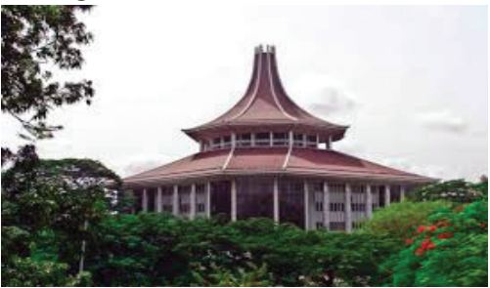
ePjp kd;wk;
cr;r ePjpkd;wk;
Nky; ePjpkd;wk;
khtl;l ePjpkd;wk;
k[p];l;Nul; ePjpkd;wk;
murpay; ahg;G ePjpkd;wk;

Slide 17
1978
,uz;lhk; FbauR ahg;G

Slide 18
1978 ahg;gpd; gpujhd gz;Gfs;
kf;fs; thf;fspg;gjd; %yk; njupTnra;J nfhz;l gpujpepjpfisf; nfhz;l ghuhSkd;wk;.
kf;fs; thf;fpd; %yk; njupT nra;ag;gl;l epiwNtw;W mjpfhuKila [dhjpgjp.
nghJ kf;fspd; ePjpkd;w mjpfhuk; ahg;gpd; %yk; cUthf;fg;gl;Ls;s ePjp kd;wj; njhFjpapy; nraw;gLj;jg;gLjy;.

Slide 19
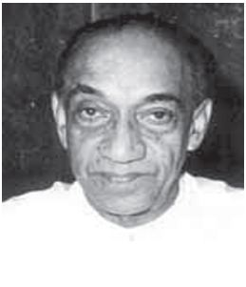
[dhjpgjp gjtp
KO ehLk; xNu Nju;jy; njhFjp vd;w mbg;gilapy; kf;fs; thf;Ffspd; %yk; epiwNtw;W mjpfhuKila [dhjpgjp njupT nra;ag;gLthu;. njupT nra;ag;gLk; [dhjpgjp 5 Mz;Lfs; jdJ gjtpia tfpg;ghu;.

Slide 20
ghuhSkd;wk;
1972 ,d; Njrpa muRg; Nguit
1978 ,y; ghuhSkd;wk; vd miof;fg;gl;lJ.

Slide 21
1978 ghuhSkd;wj; njhFjp
225 gpujpepjpfs;
tpfpjhrhu Nju;jy; Kiwapd; fPo; Njrpag; gl;bay;
196 19

Slide 22
ghuhSkd;w mjpfhuq;fs;
rl;lj;ijg; gpwg;gpj;jy;
ePjpia ifahSjy;
tuT nryT jpl;lj;ij mDkjpj;jy;
mgptpUj;jjpj; jpl;lq;fis tFj;jy;

Slide 23
1978 ahg;gpd; thf;fspg;G Kiw
[dhjpgjp Nju;jy;
tpfpjhrhu
gpujpepjpj;Jt Kiw
nghJ[d
mgpg;gpuha Kiw

Slide 24
[dhjpgjp Nju;jy; Kiw
ehL KOtJk; xNu Nju;jy; njhFjpahf fzpf;fg;gLk;. mspf;fg;gl;l thf;Ffspd; ngUk;ghd;ikia mjhtJ 50% ,w;F Nkw;gl;l thf;Ffis ngw;Wf; nfhs;Sk; mNgl;rfu; ntw;wp ngWthu;.
tpfpjhrhu gpujpepjpj;Jt Kiw
ghuhSkd;wk;> khfhz rig> cs;Suhl;rp rig vd;gtw;Wf;F mq;fj;jtu;fs; tpfpjhrhu Kiwg;gbNa njupTnra;ag;gLtu;.
nghJrd mgpg;gpuhak;
Njrpa Kf;fpaj;jtk; tha;e;j xU tplaj;jpy; Neubahf kf;fs; Mizia Nfhwg; ngWtjw;fhd xU Kiwahf ,jidf; nfhs;syhk;. Fwpg;gpl;l tplak; njhlu;ghf Mk;> ,y;iy vd;W jPu;khdpf;fshk;.

Slide 25
Rje;jpuj;Jf;Fg; gpd;duhd
mgptpUj;jp eltbf;iffs;

Slide 26
tptrha mgptpUj;jp
cyu; tyaj;jpy; FbNaw;w jpl;lq;fs;
cUthf;fg;gl;ljd; Nehf;fq;fs;
<u tya rdj;njhif mjpfupg;ig Fiwj;jy;
Ntiy tha;g;Gfis cUthf;fy;.
czT cw;gj;jpia ngUf;Fjy;
<u tyaj;jpy; fhzg;gLk; epyg;gw;whf;Fiwf;F gupfhuk; fhzy;
cyu; tya Guhjd Fsq;fs;> fhy;tha;fs;> vd;gtw;iw Gzuikj;J me;epyq;fis mgptpUj;jpr; nra;jy;.

Slide 27
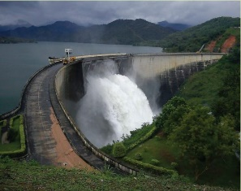
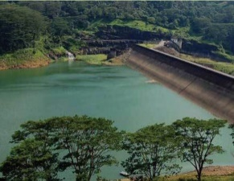
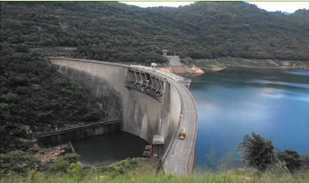
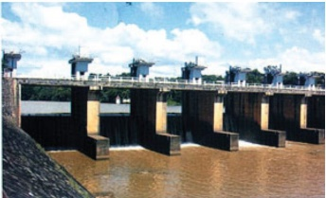
kfhtyp mgptpUj;jpj; jpl;lk;
kfhtyp jpl;lq;fSf;F cjtp toq;fpa ehLfs;
nfhj;kiy ePu;j; Njf;fk; - RtPld;
tpf;Nlhupah - gpupj;jhdpah
ue;njdpfy - N[u;kdp

Slide 28
fy;tpg; Gyj;jpy; Vw;gLj;jg;gl;l
khw;wq;fs;
murhq;f ghlrhiyfis mikj;jy;
fy;tp mgptpUj;jpf;F mjpf gzk; xJf;Fjypd; %yk; ehnlq;Fk; ghlrhiyfspd; njhif mjpfupj;jik.
ghlj;jpl;lj;ij tpUj;jpailar; nra;J Mrpupau; gapw;rp eltbf;iffs; etPdkag;gLj;jg;gl;ld.
tpQ;Qhd Ma;T $lk;> E}y; epiyak; vd;gd cUthf;fg;gl;lik.
gfy; czT> ghl E}y;fs;> gy; itj;jpak;> itj;jpak; kw;Wk; rPrd; bf;fl;> ,ytr rPUil vd;gd toq;fg;gl;ld.
1942 ,y; ,yq;if gy;fiyf;fofk; nfhOk;gpy; Muk;gpj;jik.
1952 ,y; mjid Nguhjidf;F ,lk; khw;wpaik
1972 nkhul;Lt gy;fiyf;fofk; Muk;gpf;fg;gl;lik
1947 aho;g;ghz gy;fiyf;fofk; Muk;gpf;fg;gl;lik

Slide 29
tpdhf;fs;
Nrhy;gup ahg;gpd; gb KjyhtJ Nju;jy; ,lk;ngw;w tUlk;?
,yq;ifapd; KjyhtJ
(m). gpujku; (M). vjpu;fl;rpj;jiytu;
3. Nrhy;gup ahg;gpd; tpNrl gz;Gfs; 3 jUf.
4. fPNo jug;gl;Ls;s murpay; fl;rpfspd; Njhw;Wtpg;ghsu;fisf; Fwpg;gpLf.
(m). If;fpa Njrpaf; fl;rp
(M). ,yq;if rkrkh[f; fl;rp
(,). ,yq;if Rje;jpuf; fl;rp
(<). njhopyhsu; fl;rp
(c). ngluy; fl;rp
5. 1956 kf;fs; If;fpa Kd;ddpAld; ,ize;j fl;rp vJ?
6. S.W.R.D. gz;lhuehaf;fh mtu;fspd; Ml;rp fhyj;jpy; mwpKfk; nra;ag;gl;l rPu;j;jpUj;jq;fs; 4 jUf.
7. KjyhtJ FbauR ahg;G mwpKfg;gLj;jg;gl;l Mz;L vJ?
8. 1972 ahg;gpd; gpujhd gz;Gfs; 3 jUf.
9. 1972 ahg;gpd; ePjpkd;w njhFjpapid Fwpg;gpLf.
10. ,e;ehl;bd; KjyhtJ epiwNtw;W [dhjpgjp ahu;?
11. 1978 ahg;gpd; Kf;fpa gz;Gfs; 3 jUf.
12. 2Mk; FbauR ahg;gpd; gb [dhjpgjpapd; mjpfhuq;fs; 4 jUf.
13. 2Mk; FbauR ahg;gpd; fPo; ghuhSkd;wj;jpd; mjpfhuq;fs; 3 jUf
14. 2 Mk; FbauR ahg;gpy; toq;fg;gl;Ls;s mbg;gil cupikfs; 3 jUf.

Slide 30
15. 1978 ahg;gpd; fPo; fhzg;gl;l Nju;jy; Kiwfs; 3 jUf.
16. ehl;by; tptrha FbNaw;wq;fs; cUthf;fg;gl;ljd; gpujhd Nehf;fq;fs; 3 jUf.
17. tptrha FbNaw;wq;fs; cUthf;fg;gl;l NghJ muR vjpu;Nehf;fpa rthy;fs; 3 jUf.
18 .Rje;jpuj;jpd; gpd; Njhw;wk; ngw;w tptrha FbNaw;wq;fs; 3 jUf.
19. kfhtyp mgptpUj;jpj; jpl;lk; %yk; vjpu;ghu;f;fg;gl;l Nehf;fq;fs; 3 jUf.
20. (m). nfhj;kiy (M). tpf;Nlhupah (,). ud;njdpfy Mfpa ePu;j;Njf;fq;fs; mikg;gjw;F mDruiz toq;fpa
ehLfisj; jUf.
21. ,e;ehl;bd; KjyhtJ ifj;njhopy; FbNaw;wk; vJ?
22. Rje;jpuj;Jf;Fg; gpd; mgptpUj;jpf;F gpd;gw;wpa topkiwfs; 4 jUf.
23. ,ytrf; fy;tpapd; je;ij ahu;?
24. Rje;jpuj;Jf;Fg; gpd; ,e;ehl;by; fy;tpj; Jiwapy; fhzf;$ba Kf;fpa ,yl;rzq;fs; 4 jUf.
25. ,e;ehl;bd; tu;j;jf tptrhaj;jpd; tpUj;jpf;fhf Rje;jpuj;Jf;Fg; gpd; Nkw;nfhs;sg;gl;l eltbf;iffs; 3 jUf.

