Slide 1
ghlk; - 7
cyfpy;
,lk; ngw;w Gul;rpfs;

Slide 2
Gul;rp
VNjDk; xU Jiwapy; FWfpa fhyj;jpy; Vw;gLk; khw;wj;ij Gul;rp vdyhk;.
ifj;njhopy; Gul;rp
rkag; Gul;rp
mnkupf;f Rje;jpu Nghu;
gpuhd;rpa Gul;rp
u\;ag; Gul;rp

Slide 3
mnkupf;fh Rje;jpug; Nghu;
mnkupf;f FbNaw;w thrpfs; gpupj;jhdpa Nguurpy; ,Ue;J tpLjiy ngw Nkw;nfhz;l Nghuhl;lk; mnkupf;f Rje;jpug; Nghu; my;yJ Mq;fpyg; Gul;rp vdg;gLk;.
Nghu;j;Jf;fy;> ];ghdpah> xy;yhe;J> gpuhd;];> ,q;fpyhe;J Mfpa INuhg;gpa ehLfs; mnkupf;fhtpy; FbNaw;wq;fis mikj;jd.

Slide 4
INuhg;gpau; mnkupf;fhtpy; FbNaw;wq;fis mikg;gjpy;
jhf;fk; nrYj;jpa fhuzpfs;
rka Rje;jpuj;ij vjpu;ghu;j;J kf;fs; Gjpa ,lj;jpw;F nry;y tpUk;gpaik.
tu;j;jfj;jpd; nghUl;Lg; Gjpa gpuNjrq;fspy; epyq;fisg; ngw;Wf; nfhs;stjd; %yk; tho;it rpwg;ghdjhf;fpf; nfhs;s tpUk;gpaik.
GfioAk; nry;tj;ijAk; mjpfupf;Fk; Nehf;Fld; INuhg;gpa ehLfspd; Ml;rpahsu;fs; Gjpa ,lq;fisf; fz;Lgpbg;gjw;F toq;fpa xj;jiog;G.

Slide 5
gpupj;jhdpaf; FbNaw;wq;fs; epWtg;gly;
1942 ,y; fpwp];Nlhgu; nfhyk;g]; fuPgpad; flypy; gfhkh]; jPtpy; jiu ,wq;fpdhu;.
nfhyk;g]pd; tUiff;F Ie;J tUlq;fspd; gpd; mnkupf;fh nt];Grp jw;Nghija mnkupf;fh fz;lj;ijf; fz;Lgpbj;jhu;.
];ghdpaUk; Nghu;j;Jf;NfaUk; njd; mnkupf;fhtpy; FbNaw;wq;fis epWtpdu;.
mnkupf;f If;fpa mnkupf;fh vd;w ehL gpupj;jhdpauhy; tl mnkupf;fhtpy; epWtg;gl;l FbNaw;wq;fis ikakhff; nfhz;L Njhw;wk; ngw;wJ.

Slide 6
gpupj;jhdpauhy; mnkupf;fhtpy;
epWtg;gl;l FbNaw;wq;fs;
1. Ntu;[pdpah
2. krhRnrw;];
3. epANahu;f;
4. epA`k;nrau;
5. Nkupyhe;J
6. fdubf;fl;
7. Nuhl;jPT
8. nltu;
9. tl fNuhypdh
10. epA+n[u;rp
11. njd; fNuhypdh
12. ngd;ry; Ntdpah
13. N[hu;[pah

Slide 7
mnkupf;fh FbNaw;wq;fspy;
gpupj;jhdpa epUthfk;
,e;jg; gjpd;%d;W FbNaw;wq;fspd; epu;thfk; me;je;jf; FbNaw;wq;fSf;F epakpf;fg;gl;l MSeu;fshy; Kd;ndLj;Jr; nry;yg;gl;lJ.
1763 Mk; Mz;Lf;F Kd;du; mnkupf;fh FbNaw;wthrpfs; vjpu;Nehf;fpa ,U gpur;rpidfs;.
1. gpuhd;]paupd; mr;RWj;jy;
2. nrt;tpe;jpaupd; mr;RWj;jy;
gpuhd;]pw;Fk; gpupjhdpahtpw;Fk; ,ilapy; ,lk; ngw;w Vohz;Lg; Nghupy;
(1756 – 1763) gpuhd;]; Njhy;tpAw;wJ.
gpupj;jhdpaupd; ghJfhg;G cghaq;fspdhy; nrt;tpe;jpaupd; mr;RWj;jy; Fiwtile;jJ.

Slide 8
mnkupf;f Rje;jpug; NghUf;fhd gpd;dzp
gpupj;jhdpah mwpKfk; nra;j rl;lq;fspdhy; FbNaw;wq;fSf;Fk; jha; ehl;Lf;Fk; ,ilNa fUj;J NtWghL Njhd;wpaik.
Vohz;Lg; Nghupd; gpd;du; gpupj;jhdpah jdJ fld; Rikia mnkupf;f FbNaw;wq;fspd; kPJ Rkj;j eltbf;if vLj;jik.

Slide 9
mnkupf;f Rje;jpug; NghUf;fhd fhuzq;fs;
mnkupf;f FbNaw;wthrpfs; ePz;l fhykhfg; gpupj;jhdpa jiyaPl;bw;F khwhf Raepu;thfj;jpw;Fg; gof;fg;gl;bUe;jik.
gpupj;jhdpau; gpd;gw;wpa jha; ehl;Lf;F rhjfkhd nghUshjhuf; nfhs;if.
FbNaw;wthrpfspd; vz;zq;fs; kdepiyfs; fUj;Jf;fis gpupj;jhdpa murhq;fk; rupahf Gupe;Jnfhs;shik.
1763 Mk; Mz;bd; gpd; mKy; nra;ag;gl;l Gjpa tupfs;.
FbNaw;wthrpfspd; ePjpahd Nghuhl;lq;fisf; fl;Lg;gLj;j gpupj;jhdpah eltbf;if vLj;jik.
Rje;jpuk; njhlu;ghf FbNaw;wthrpfspilNa fhzg;gl;l Mu;tk;.

Slide 10
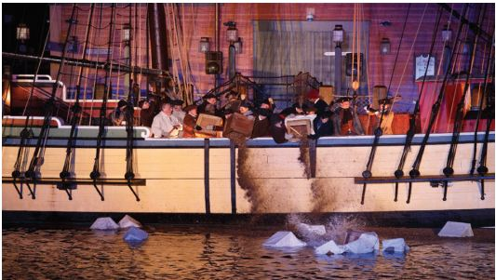

Slide 11
Rje;jpug; Nghupd; tpisTfs;
If;fpa mnkupf;f ehLfs; vd;w Rje;jpu muR cjakhfpaJ.
KO kdpj Fyj;jpw;Fk; Rje;jpuj;jpd; Nkd;ikia vLj;Jf; fhl;ba re;ju;g;gkhf mike;jJ.
mbg;gil kdpj cupikfs; gw;wpa czu;T cyfk; KOtJk; Vw;gl;lJ.
mnkupf;f If;fpa ehLfSf;nfd tiuag;gl;l murpay; ahg;ghdJ cyfpy; Kjd;Kjy; vOjg;gl;l murpay; ahg;ghf cUthdJ.

Slide 12
gpuhd;rpag; Gul;rp
(1789)

Slide 13
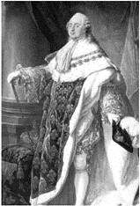
gpuhd;rpag; Gul;rp
1789 Mk; Mz;L gpuhd;rpd; Kbahl;rpf;F vjpuhf vOe;j me;ehl;L kf;fs; Kbahl;rpia ftpo;j;J Gjpa Ml;rpia Vw;gLj;jpaik gpuhd;rpag; Gul;rp vdg;gLk;.

Slide 14
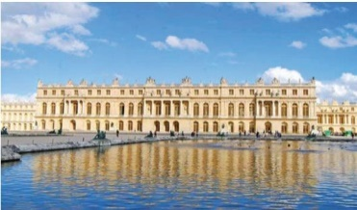
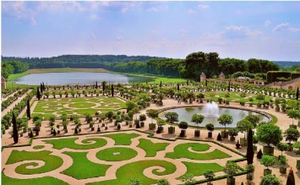
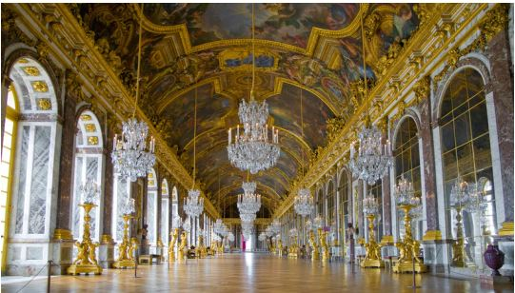
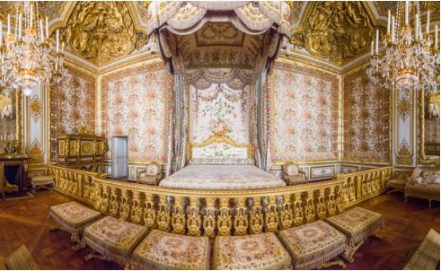
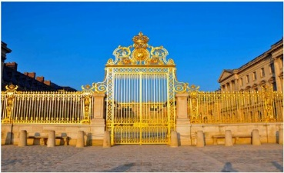
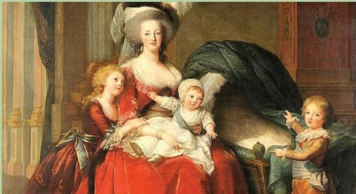
gpuhd;rpag; Gul;rpf;fhd murpay; fhuzpfs;
14 Mk; Y}ap> 16 Mk; Y}ap kd;du;fsplk; Ftpe;jpUe;j vy;iyaw;w mjpfhuk;.
16 Mk; Y}ap kd;ddpd; RfNghf tho;f;if.
murpaypy; fhzg;gl;l Coy; Nkhrbfs;.
kf;fs; Fiwfis Kd;itf;Fk; gpuhd;rpa ghuhSkd;wk; 175 Mz;Lfs; $l;lg;glhik.

Slide 15
r%ff; fhuzpfs;
gpuhd;rpy; epytpa khdpa Kiwapy; fhzg;gl;l FiwahLfs;.
gpuGf;fSk; FUkhUk; mDgtpj;j rYiffs;.
kj;jpa ju tu;f;fj;jpdupd; Njhw;wKk; r%fj;jpy; mtu;fSf;F cupa ,lk; toq;fg;glhikAk;.
gpuhd;rpy; rhjhuz kf;fs; Kfk; nfhLj;j gpur;rpidfs;.
nghUshjhuf; fhuzpfs;
murpdJk; mur FLk;gj;jpdJk; Mlk;gut tho;f;ifapdhy; Vw;gl;l mjpf nryT> Njitg;gl;l Aj;j nryT vd;gtw;why; gpuhd;rpd; jpiuNrup ntWikahdik.
tpidj; jpwdw;w tup Kiwfs;.

Slide 16
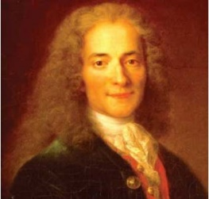
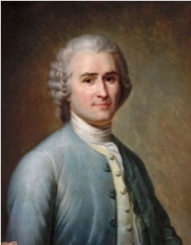
gpuhd;rpag; Gul;rpf;F gq;fspg;G toq;fpa
jj;Jt Qhdpfs;
nkhz;l];fpA
Nthy;lau;
&Nrh

Slide 17
gpuhd;rpag; Gul;rpapd; tpisTfs;
mbg;gil cupikfs; njhlu;ghf cyfk; KOJk; Mu;tk; Vw;gl;lJ.
gpuhd;rpy; Kbahl;rp tPo;r;rpAw;wik.
gpuhd;rpa tptrhaj; njhopyhd kf;fSf;Fr; rYif fpilj;jik.
gpuhd;rpy; cWjpaw;w murpay; Kiw Njhd;wpaik.

Slide 18
u\;ag; Gul;rp
(1917)

Slide 19
u\;a Gul;rp
‘czT> epyk;> rkhjhdk;’ vDk; RNyhfq;fSld; 1917 khu;r;> xf;Nlhgu; khjq;fspy; u\;ahtpy; ,lk;ngw;w ,U Gul;rpfis u\;a Gul;rp vdyhk;.

Slide 20
u\;ag; Gul;rpf;fhd fhuzpfs;
u\;ahtpy; epytpa Coy; epiwe;j ru;thjpfhu Ml;rp.
u\;ahtpy; epytpa khdpa Kiwapd; FiwghLfs;.
njhopyhsu;fspd; Njhw;wKk; mtu;fspd; cupikfs; kWf;fg;gl;likAk;.
kf;fs; vjpu; Nehf;fpa gpur;rpidfs;.
gil tPuu;fspd; Njitfs; Gwf;fzpf;fg;gl;lik.

Slide 21
khu;r; khjg; Gul;rp
,g;Gul;rpf;F njhopw;rhiy xd;wpy; Vw;gl;l Ntiy epWj;jNk fhuzkhFk;. kf;fs; ghz; Nfl;L Mu;g;ghl;lk; nra;jdu;. rhu; kd;dupd; gilapdu; Mu;g;ghl;lj;jpy; ,ize;Jf; nfhz;ldu;. ,e;jg;Gul;rpapd; gpd; rhu; kd;dd; gjtp Jwe;jTld; nfnud;rpf; vd;w jiytupd; fpsu;r;rp mzpapdupd; iff;F khwpaJ.
1917 Mk; Mz;L mf;Nlhgu; khjg; Gul;rp
nydpd; jiyikapyhd Nghy;]tpf; fl;rp Nrhtpal; kz;lyk; vd;w mikg;gpid ehL KOtJk; epWtp tptrha> njhopyhsu; murhq;fj;ij mikf;f eltbf;if vLj;jJ.
u\;ag; Gul;rp Muk;gpf;Fk; NghJ nkd;rtpf;> Nghy;rtpf; vd;w ,U murpay; FOf;fs; ,Ue;jJ.
nydpdJk; nuh];fpapdJk; jiyikapy; nray;gl;L nghJ cilik muRf;F njhopyhsu; tptrhapfs;> giltPuu;fs; xj;Jiog;G fpilj;jJ. ,tu;fshy; jkJ Njitfshd czT> epyk; rkhjhdj;ij Ntz;b mf;Nlhgu; Gul;rp Vw;gl;lJ.

Slide 22
Gul;rpapd; tpisTfs;
nfud;];fpapd; jiyikj;Jtj;jpyhd muirf; ftpo;j;J nydpd; jiyikj;Jtj;jpyhd Nghy;n\tpf;Ffspd; muir Njhw;Wtpj;jik.
nydpd; jiyikapyhd Gjpa murhq;fk; N[u;kdpAldhd Aj;jj;ij epWj;jp rkhjhdj;ij Vw;gLj;jpaJ.
nydpdpd; jiyikapy; murhq;fk; epykhdpa Kiwapy; fhzg;gl;l FiwghLfis ePf;fpaJ. ,jdhy; tptrhapfSf;F epyk; fpilj;jJ.
njhopw;rhiyfs; midj;Jk; mur clikahf;fg;gl;ljhy; njhopyhsu;fspd; gpur;rpidf;F jPu;T fhzg;gl;lJ.
rhu; kd;du;fspd; Ml;rp KbTw;wJ.
u\;a Nrhtpal; rkTilik FbauR vd;w ngaupy; mwpKfkhdJ.
cyfk; KOJk; rkTilikf; nfhs;if gutpaik.

Slide 23
tpdhf;fs;

Slide 24
mnkupf;fh Rje;jpug; Nghu;
gFjp - 1
1. mnkupf;fhtpd; goq;Fbfs; ahu;?
2. mnkupf;fhtpy; FbNaw;wq;fis mikj;j INuhg;gpa ,dj;jtu;fs; ehy;tiu vOJf.
3. mnkupf;fhtpy; gpupj;jhdpauhy; epWtg;gl;l Kjy; FbNaw;wk; vJ?
4. mnkupf;fhtpy; gpupj;jhdpauhy; epWtg;gl;l ,Wjpf; FbNaw;wk; vJ?
5. Vohz;L Nghu; ve;j ,U ehl;bdUf;F ,ilNa ,lk; ngw;wJ?
6. gpupj;jhdpah ghuhSkd;wj;Jf;F tup tpjpf;Fk; cupik ,y;iy vd;gJld; njhlu;Gila Nfh\k;
7. gpupj;jhdpauhy; mnkupf;fhtpw;F Vw;Wkjp nra;j nghUl;fspy; tup tpjpf;fg;gl;l nghUl;fs; 3 jUf.
8. mnkupf;fh Rje;jpug; Nghupd; Kjy; fl;lk; vJ?
9. mnkupf;fh Rje;jpug; NghUf;Fj; jiyik jhq;fpatu; ahu;?
10. mnkupf;fh Rje;jpug; gpufldk; ntspapl;l Mz;L vJ?
11. mnkupf;fh Rje;jpug; gpufldj;jpy; mlq;fpAs;s gjk; vJ?
12. cyfpy; Kjd;Kjy; murpay; ahg;ig cUthf;fpa ehL vJ?
vJ?

Slide 25
gFjp – 11
1). INuhg;gpau; mnkupf;fhtpy; FbNaw;wq;fis mikj;jikf;fhd fhuzq;fs; 3 jUf.
2). gpupj;jhdpauhy; mnkupf;fhtpy; epWtg;gl;l FbNaw;wq;fs; 5 jUf.
3). mnkupf;f Rje;jpug; NghUf;fhd fhuzq;fs; 3 If; Fwpg;gpLf.
4). gpupj;jhdpa gpujku; N[hd; fpud;tpy; %yk; mnkupf;f FbNaw;w thrpfs; kPJ mwtplg;gl;l tupfs; 3 Ij; jUf
5). mnkupf;f Rje;jpug; Nghupd; tpisTfs; 3 Ij; jUf.

Slide 26
gpuhd;]; Gul;rp
gFjp – 1
1. gpuhd;rpa Gul;rpapd; jhuf ke;jpuk; vJ?
2. 14Mk;> 16Mk; Y}ap kd;du;fspd; mur tk;rk; ahJ?
3. ‘ehNd muR’ vd;W $wpa kd;dd; ahu;?
4. gpuhd;rpa Gul;rpapd; NghJ Kjd; Kjy; jhf;fg;gl;l rpiwr;rhiy vJ?
5. gpuhd;rpa kd;du;fs; tho;e;j Mlk;gu khspif vJ?
6. gpuhd;rpa ghuhSkd;wk; vg;ngauhy; miof;fg;gl;lJ?
7. gpuhd;rpd; rhjhuz Fbkf;fs; nrYj;jpa %d;W tupfSk; vit?
8. nghJkf;fspd; tPLfs; epyq;fspy; ,Ue;J ngwg;gl;l tup vJ?
9. ‘rl;lj;jpd; rhuk;’ vDk; E}iy vOjpatu; ahu;?
10. &Nrhtpdhy; vOjg;gl;l E}y; vJ?
11. fUj;J ntspapLk; cupikg; gw;wp jfty; Kd;itj;j jj;Jt Qhdp ahu;?
12. g];By; rpiwr;rhiy cilf;fg;gl;l Mz;L vJ?
13. gpuhd;rpa Gul;rpahsu;fshy; Njrpa ghJfhg;G gilf;fhd jiytuhf epakpf;fg;gl;ltu; ahu;?
14. gpuhd;rpa Gul;rpapd; tpisthf mbg;gil cupikfs; njhlu;ghd gpuflzk; ntspaplg;gl;lMz;L vJ?
15. gpuhd;rpa Gul;rpapd; gpd; Gjpa murpaypy; epiyikia cUthf;fpatu; ahu;?

Slide 27
gFjp – 11
gFjp – 11
1). gpuhd;rpa Gul;rpf;fhd murpay;> nghUshjhu> r%f fhuzpfis ml;ltizg; gLj;Jf.
2). gpuhd;rpa epyg;gug;Gfs; mDgtpj;j cupikfs; ,uz;ilf; Fwpg;gpLf.
3). gpd;tUk; tupfis RUf;fkhf tpsf;Ff.
A. nlyp B. nfngy; C. nfg;gpNl\d;

Slide 28
u\;ag; Gul;rp

