Slide 1
cyf kfh Aj;jk;

Slide 2
Kjyhk;
cyf kfh Aj;jk;

Slide 3
Kjyhk; cyf kfh Aj;jk;
1914-1919 tiuapyhd fhyg; gFjpapy; cyfk; KOtJk; gutpa Aj;jk; Kjyhk; cyf kfh Aj;jk; vd miof;fg;gLfpd;wJ.

Slide 4
Kjyhk; cyf kfh Aj;jj;jpw;fhd
fhuzq;fs;
FbNaw;wq;fs; Fwpj;j Nghl;b ehLfs; njhopy;El;g mile;jjhy; INuhg;gpa ,dj;jth; %yk; nghUs; kw;Wk; tpahghuk; njhlu;ghf Vw;gl;l N;ghl;b
my;Nr]; nyhiud; gpur;rpid
N[h;kdpia If;fpag;gLj;Jk; eltbf;ifapd; NghJ gpuhd;Rk; N[h;kdpAk; gifik ehLfshf cUntLj;jik.
gpupj;jhdpa – N[u;kdpa ,uhZtg; N;ghl;b
FbNaw;w ehLfis cUthf;Ftjpy; Vw;gl;l N;ghl;b
INuhg;gh ,U mzpfshf gpupjy;
MAj N;ghl;bAk; ,dthj tsu;r;rpAk;
N[h;kd; N;guuRfspd; (nfa;ru;) ntspehl;L nfhs;iffs

Slide 5
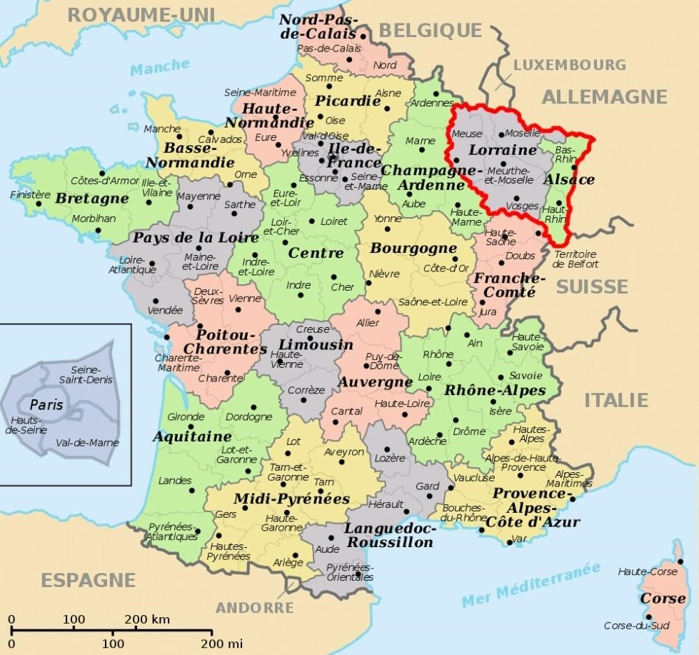
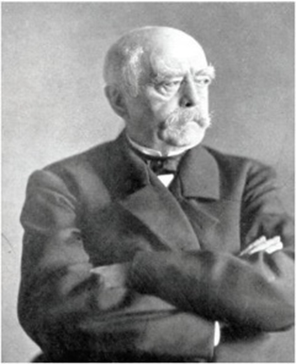
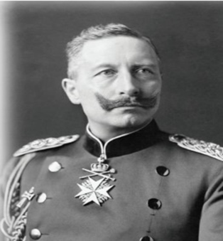

Slide 6
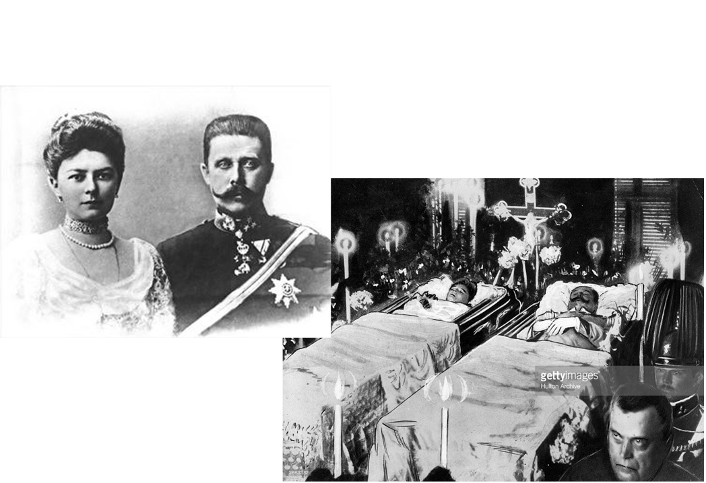
1914 ruh[pNth epfo;T

Slide 7
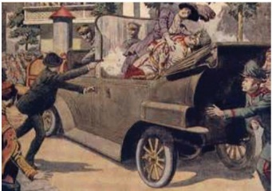
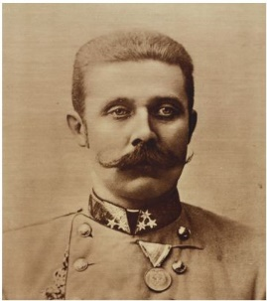
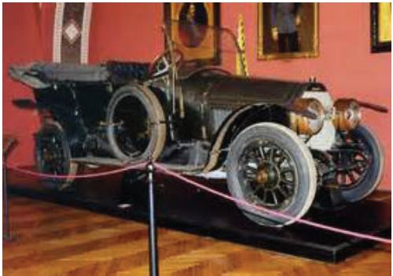

Slide 8
mzpfs;
kj;jpa INuhg;gh ty;yuR mzp
el;G ehLfs; mzp
N[u;kdp
M];jpupah
`q;Nfup
gy;Nfupah
JUf;fp
gpupj;jhdpah &Nkdpah
gpuhd]; ,j;jhyp fpuP]; Nru;gpah
u\;ah

Slide 9
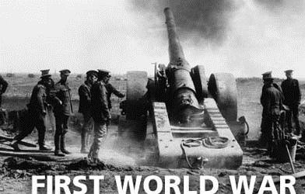
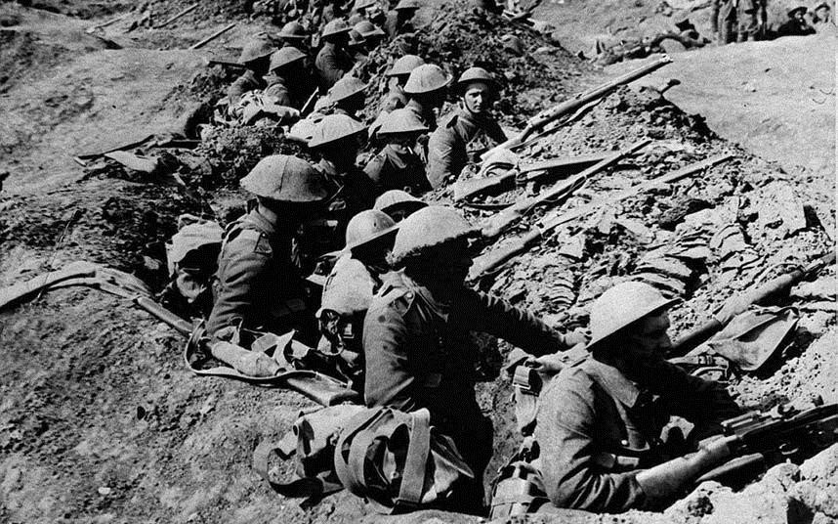

Slide 10
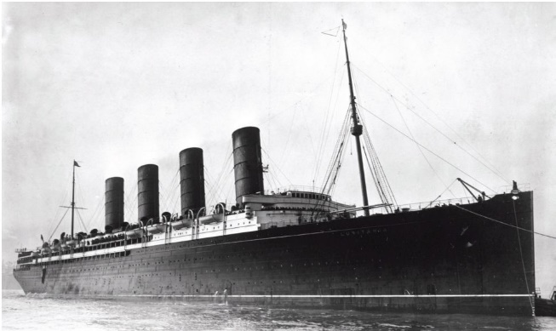
N[h;kdpahpd; mnkhpf;f gazpfs; fg;giy jhf;fpaik.
mnkhpf;fh cyf kfh Aj;jj;jpy; <LgLjy; ..

Slide 11
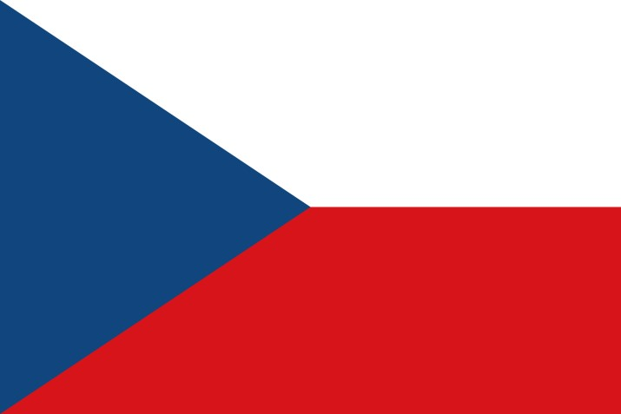
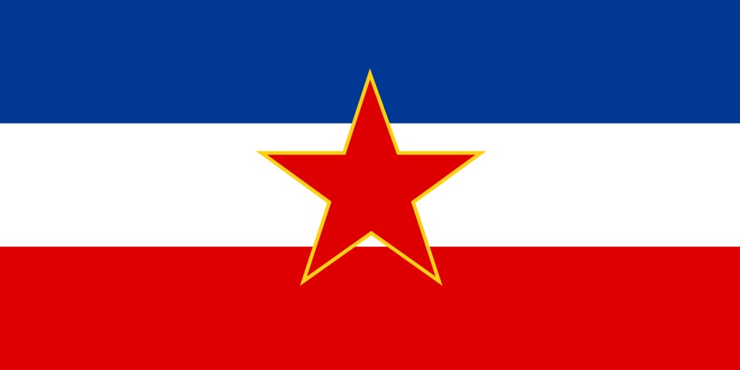
tpisTfs;
ngUe;njhifahd kdpj caph;fSk; nrhj;JfSk; mope;jd
Nth;Nry;];; cld;gbf;ifapd; %yk; N[h;kdpf;F fLk; jz;lidfis gpwg;gpj;jy;.
myNr]; - nyhiud; gpuNjrq;fs; kPz;Lk; gpuhd;Rf;F fpilf;fg;ngw;wik.
Rje;jpu muRfs; Njhw;wk; ngwy;
nrf;Nfh];NyhNtf;fpah> ANfh];NyhNtf;fpah
KO INuhg;ghTk; nghUshjhuj;Jiwapy; tPo;r;rpaile;jJ.
cyif ghJfhf;Fk; nghUl;L rh;tNjr rq;fk; Muk;gpj;jy;

Slide 12
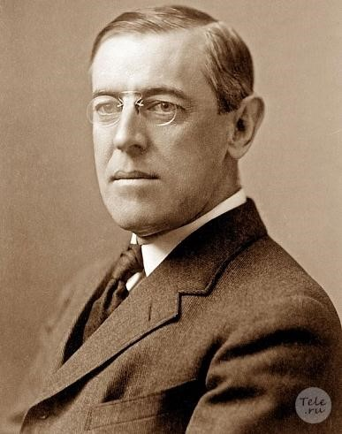
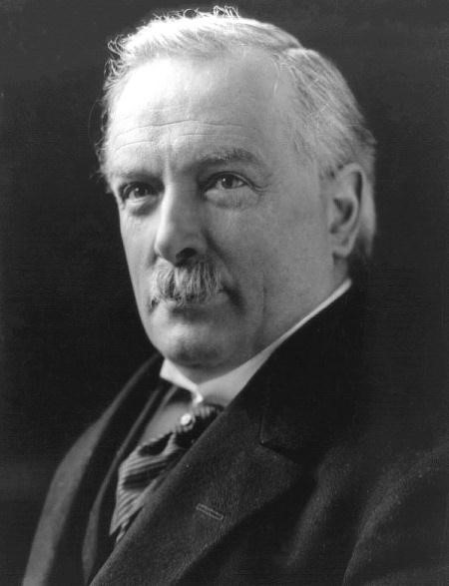
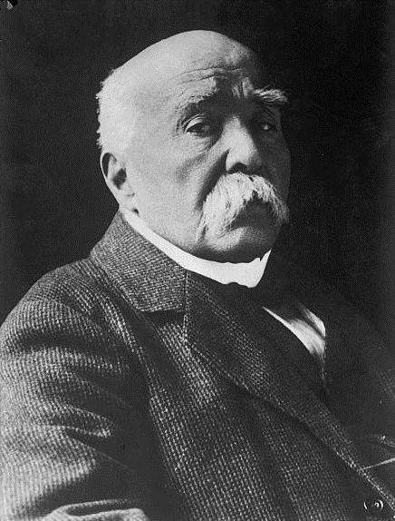
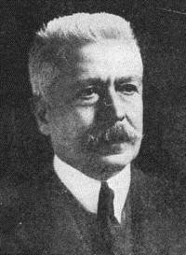
ru;tNjr rq;fk;
Muk;gk; 1920 [dthp 10 ( 42 ehLfs;)
mnkhpf;f [dhjpgjp Tl;Nuh tpy;rd; gphpj;jhdpa gpujkh; nyhapl; N[hh;[;
gpuhd;]; gpujkh;; f;nskd; N\h ,j;jhypa gpujkh;; tpl;Nlhhpah xnyz;Nlh

Slide 13
cUthf;fpajd; Nehf;fk;
ehLfSf;fpilNa Vw;gLk; fUj;J Kuz;ghLfis rkhjhdkhf jPu;j;jy;.
vjph;fhyj;jpy; cyf Aj;jk; xd;W Vw;gLtijj; jtph;j;jy;.
kdpj Fy ,Ug;gpw;F Njitahd eltbf;iffis Nkw;nfhs;sy;.
Nghuhl;lq;fis jLj;Jf;nfhs;Sjy;.
rh;tNjrg; Ghpe;Jzh;itAk; xj;Jiog;igAk; fl;b vOg;Gjy;
rpwpa ehLfspd; Rje;jpuk; RahjPdk; vd;gtw;iw ghJfhj;jy;
kdpj Fy xw;Wik %yk; cyf rkhjhdj;ij ghJfhj;jy;

Slide 14
rkhjhdj;jpw;fhf Nkw;nfhs;sg;gl;l Kaw;rpfs;
Aj;j Kuz;ghLfis jtpu;j;jik.
N;[u;kDf;Fk; Nghye;Jf;Fk; ,ilapy;
<uhDf;Fk; JUf;fpf;Fk; ,ilapy;
ru;tNjr rq;fj;jpd; ek;gpf;if nghWg;gpd; fPopUe;j FbNaw;w ehLfs; Fwpj;j Nkw;ghu;it eltbf;iffis Nkw;nfhs;sy;
mfjpfs; Gzu;tho;tpw;fhd eltbf;if vLj;jik
Neha;fis xopj;jy;
rl;l tpNuhjkhd mbik tpahghuj;ijAk; Nghijg;nghUs; tu;j;jfj;ijAk; xopg;gjw;F eltbf;if Nkw;nfhs;sy;.

Slide 15
Njhy;tpailtjw;fhd fhuzq;fs;
If;fpa mnkupf;fh ru;tNjr rq;fj;jpy; ,lk; ngwhik.
N[u;kDf;F mq;fj;Jtk; ngw;Wf; nfhLf;fhik
epue;ju ,uhZtk; xd;W ,y;yik
gyk;tha;e;j ehLfSf;fpilNa xw;Wikapd;ik.
ru;tNjr rq;fk; vLj;j jPu;khdq;fis nraw;gLj;Jtjw;fhf mq;fj;jt ehLfis epu;g;ge;jpg;gjpy; Njhy;tp fhzy;.

Slide 16
,uz;lhk;
cyf kfh Aj;jk;

Slide 17
,uz;lhk; cyf kfh Aj;jk;
1939 nrg;lk;gu; - 1945 tiu cyfpd; eilngw;w gaq;fukhd Aj;jj;ij ,uz;lhk; cyf kfh Aj;jk; vd miog;gu;.

Slide 18
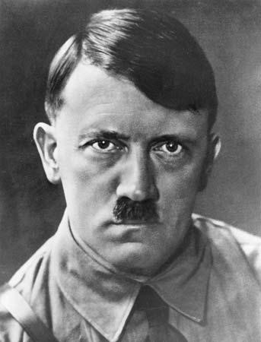
fhuzpfs;
N[u;kdpapy; `pl;yupd; vOr;rpAk; mtupd; eltbf;ifAk;.
ehrprthjk;
mNlhy;g; `pl;yu;
(nrf;Nfh];nyhntf;fpah – Nghye;J Mf;fukpg;G)

Slide 19
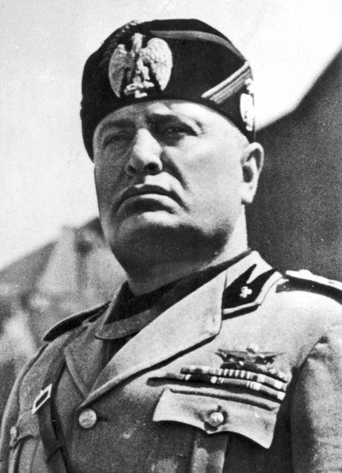
KNrhypdpapd; nra;wghLfs;
ghrpr thjk;
ngdpNlh KNrhypdp
(,jpNahg;gpah> mgprPdpahit> ifg;gw;wpf; nfhs;sy;)

Slide 20
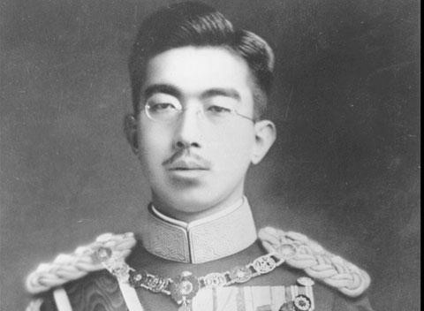
[g;ghdpd; nraw;ghLfs;
`pNuh `pj;j
(rpdhtpw;F nrhe;jkhd kQ;#upahit Mf;fpukpj;jy;)
ru;tNjr rq;fj;jpd; gytPdk;

Slide 21
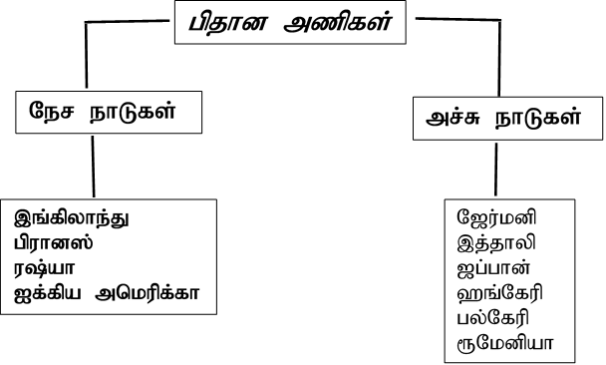

Slide 22
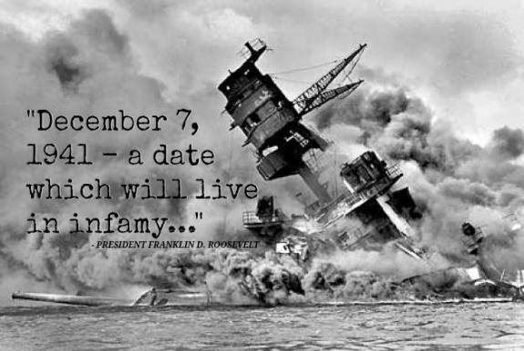
Aj;jj;jpd; guty;
Ngs; JiwKfj;ij jhf;Fjypdhy; mnkupf;fh cyf Aj;jj;jpy; <Lgly;
N[u;kdp u\ahit Mf;fpukpj;jy;
N[u;kdp mbgzpjy;
[g;ghd; ruziljy;

Slide 23
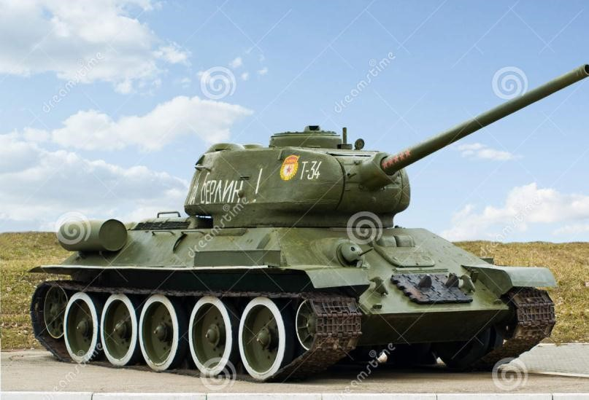
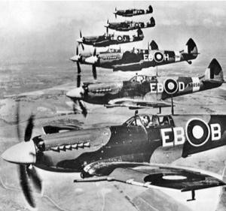
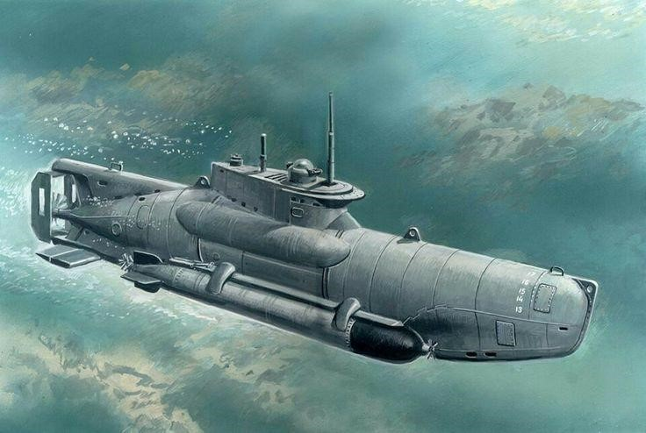
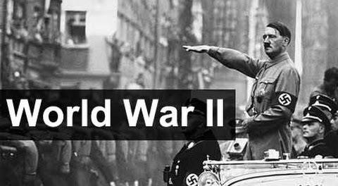
,uz;lhk; cyf kfh Aj;jj;jpd;
rpy re;ju;g;gq;fs;

Slide 24
tpisTfs;
mr;R ehLfs; mzp Njhy;tp miljy;
50 kpy;ypaDf;F mjpfkhNdhu; kuzkiljy;
,Jtiu cyfpy; eilngw;w Aj;jq;fspy; kpfg; gaq;fukhdJ
gpupj;jhdpahTk; gpuhd;Rk; cyf ty;yurhf ,Ue;j ,lj;ij ,oe;jik
cyf Kfhk;fs; ,uz;lhf gpupe;J nraw;gLjYk; gzpg; NghUk;
,ufrpa cyTr; Nrit (CIA/KBG/Mosad)
mikg;Gf;fis mikj;jy; (Neto/Warso)
cjTk; nraw;jpl;lq;fis tpupTgLj;jy; (Marsel/Project)

Slide 25
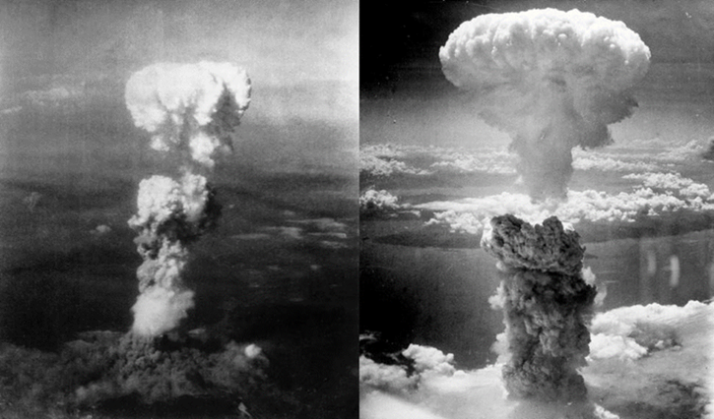
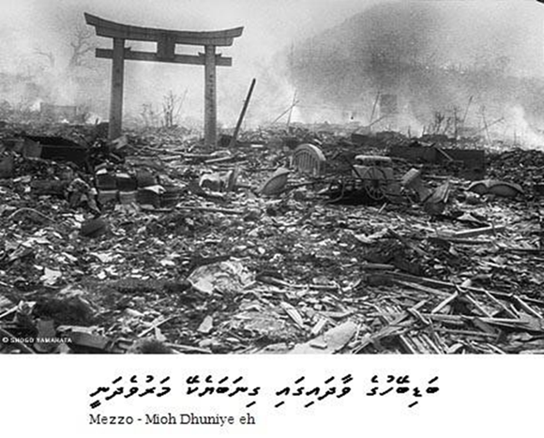
khu;\y; jpl;lj;jpd; %yk; mopTf;Fs;shd ehLfSf;F cjtpfs; ngw;Wf; nfhLj;jy;. ( [g;ghd; - N[u;kdp )
FbNaw;w ehLfSf;F Rje;jpuk; fpilj;jy;.
ru;tNjr rkhjhdj;ij ghJfhj;J> ehLfSf;fpilNa el;Gwit tsu;g;gjw;fhf If;fpa ehLfs; rig mikf;fg;gly;.
[g;ghDf;F mZFz;L Nghlg;gly;
N[u;kdp ,uz;lhf gpupf;fg;gly;.
If;fpa mnkupf;fhTk; u\;ahTk; cyf ty;yurhf vOr;rp ngw;wik

Slide 26
rkhjhdk; rftho;T kw;Wk; ,dq;fSf;fpilNa el;GwT vd;gd ,uz;lhk; cyf kfh Aj;jj;jpd; gpd; tsu;r;rp mile;jik.

Slide 27
If;fpa ehLfs;
rig

Slide 29
cjak;
1945 xf;Nlhgu; khjk; 24 nrd; gpuhd;rp];Nfh efupy;
If;fpa ehLfs; jpdk;
xf;Nlhgu; 24
mq;fj;Jt ehLfspd; vz;zpf;if
195

Slide 30
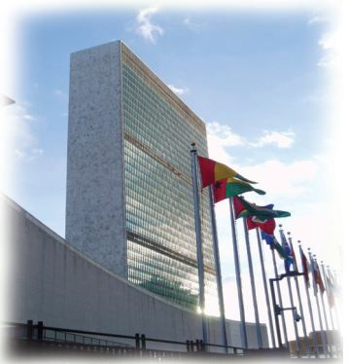
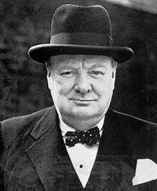
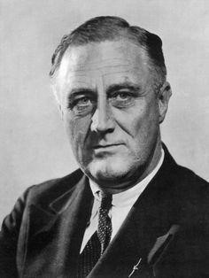
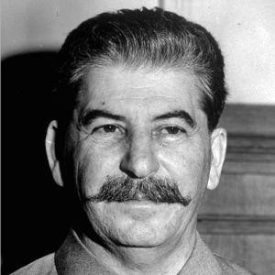
mikg;gjw;F Kd; epd;Nwhu;
gpupj;jhdpa gpujku;
tpd;rd;l; Nru;r;rpy;
mnkupf;fh [dhjpgjp
gpNuq;f;ypd; B U];l;Nty;l;
u\;ah jiytu;
N[hrg; ];lhypd;

Slide 31
mikf;fg;gl;ljd; Nehf;fk;
ru;tNjr rkhjhdj;ijAk; ghJfhg;igAk; epiy
epWj;jy;
ehLfSf;fpilNa el;Gwit tsu;j;jy;
kdpj cupikfs; kw;Wk; mbg;gil Rje;jpuj;ij
cWjpnra;jy;

Slide 32
rq;fj;jpd; fl;likg;G
nghJr; rig
ghJfhg;Gr; rig
r%f nghUshjhu rig
(ILO/FAO/UNESCO/WHO/UNICEP/IMH)
ek;gpf;if nghWg;Gr; rig
ru;tNjr ePjpkd;wk; (N`f; efupy;)
nrayfk;

Slide 33
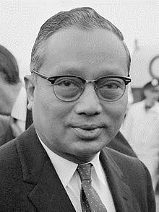
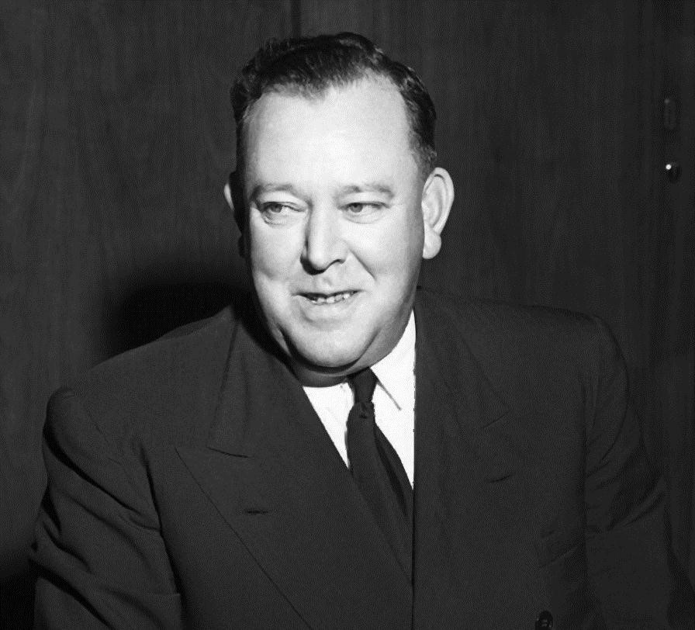
KjyhtJ nrayhsu;
lf; tpop
(Nehu;Nt[pah)
KjyhtJ Mrpa ehl;L nrayhsu;
C jhd;

Slide 34
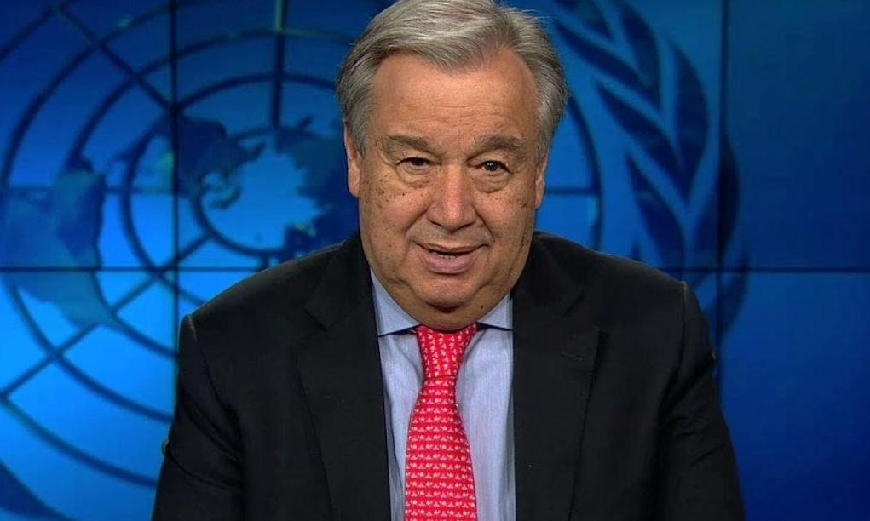
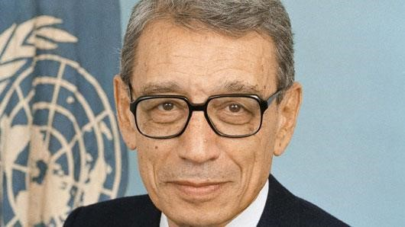
KjyhtJ Mgpupf;f nrayhsu;
G+u;Njh]; fhsp
(vfpg;J)
jw;Nghija nrayhsu;
mz;NjhdpNah FjNu];

Slide 35
rkhjhdk; njhlu;ghf vLf;fg;gl;l
Kaw;rpfs;
Ra]; neUf;fbia jPu;j;jy;
tisFlh neUf;fbia jPu;j;jy;
fpAghtpd; VTfid neUf;fbia jPu;j;jy;

Slide 36
rkhjhdj;ij ghJfhg;gjw;fhf vLf;fg;gLk;
eltbf;iffs;
nghUshjhu jil tpjpj;jy;
mZ MAjq;fis fl;Lg;gLj;j eltbf;if vLj;jy;
rkhjhdg; gilia <LgLj;jy;
Ngr;R thu;j;ijfs; %yk; gpur;rpidfSf;F jPu;T fhzy;

Slide 37
tpdhf;fs;
1. Kjyhk; cyf kfh Aj;jk; eilngw;w fhy tiuaiw ahJ?
2. Kjyhk; cyf kfh Aj;jk; eilngWtjw;fhd fhuzq;fs; 4 jUf.
3. el;G ehLfs; mzp> kj;jpa ty;yuR mzp Mfpa gpupTfspy; ,Ue;J ,t;tpU
ehLfis cjhuzkhfj; jUf.
4. Kjyhk; cyf kfh Aj;jk; Vw;gLtjw;fhd Kf;fpa fhuzk; ahJ?
5. my;Nr]; nyhiwd; gpur;rpid vd;why; vd;d?
6. Kjyhk; cyf kfh Aj;jk; Vw;gLtjw;fhd cldb fhuzk; ahJ?
7. Kjyhk; cyf kfh Aj;jj;jpy; mnkupf;fh njhlu;G gLtjw;F fhuzk; ahJ?
8. Kjyhk; cyf kfh Aj;jj;jpd; tpisTfs; 3 jUf.
9. Kjyhk; cyf kfh Aj;j ,Wjpapy; ifrhj;jplg;gl;l xg;ge;jk; ahJ?
10. Ntu;Nry;]; xg;ge;jj;jpd; %yk; jz;lid toq;fg;gl;l ehL vJ?

Slide 38
11. Kjyhk; cyfg; Nghupd; gpd; cUthd Gjpa ehLfs; 2 jUf.
12. ru;tNjr rq;fj;ij cUthf;Ftjw;F Kd;dpd;W cioj;jtu;fs; ahu;?
13. ru;tNrr rq;fj;jpd; Muk;g cWg;gpdu;fs; vj;jid?
14. ru;tNrr rq;fj;jpd; Nehf;fq;fs; 2 jUf.
15. ru;tNrr rq;fk; Njhy;tp ngw;wikf;fhd fhuzq;fs; 2 jUf.
16. ,uz;lhk; cyf kfh Aj;jk; eilngw;w fhy tiwaiu ahJ?
17. ,uz;lhk; cyf kfh Aj;jj;jpw;fhd fhuzq;fs; 3 jUf.
18. ,uz;lhk; cyf kfh Aj;jk; Vw;gl gpujhdkhf ,Ue;jtu; mNlhy;g;
`pl;yu; Mthu;.
m. Nehf;fk; M. E}y; ,. ,ufrpa nghyp]; <. ,ufrpa ,uhZtk;
19. ,uz;lhk; cyf kfh Aj;jk; Vw;gLtjw;fhd gpujhd fhuzk; ahJ?
20. ,uz;lhk; cyf kfh Aj;jj;jpy; gq;Fgw;wpa Ner ehLfs;> mr;R ehLfs; Mfpa
gpupTfspy; ,Ue;J ,uz;L ehLfs; tPjk; jUf.

Slide 39
21. ngdpNlh Knrhypdpapd;
ehL
thrfk;
gil
22. ag;ghd; Mf;fpukpj;j rPdhTf;Fupa gpuNjrk; ahJ?
23. ,uz;lhk; cyf kfh Aj;jj;jpy; mnkupf;fh <LgLtjw;fhd fhuzk; ahJ?
24. mnkupf;f Fz;Lf;fs; tPrg;gl;l [g;ghDf;Fupa 2 efuq;fs; ahJ?
25. ,uz;lhk; cyf kfh Aj;jj;jpd; tpisTfs; 4 vOJf.
26. gzpg;Nghu; vd;why; vd;d?
27. gzpg;Nghu; fhyj;jpy; jkJ Kfhk;fis ntw;wp ngw nra;tjw;F
Nkw;nfhs;sg;gl;l cghaq;fs; ahJ?
28. mzpNruh kfh ehl;il epWTtjw;F topfhl;bahf jpfo;e;j ,e;jpa jiytu;
ahu;?

Slide 40
29. cyf rkhjhdj;ij Vw;gLj;Jk; Nehf;fpy; ,uz;lhk; cyf kfh Aj;j Kbtpy;
Muk;gpf;fg;gl;l mikg;G ahJ?
mjd; Muk;g cWg;gpdu;fspd; vz;zpf;if
Muk;g jiytu;fs;
30. 1938 Mk; Mz;L `pl;yu; Mf;fpukpj;J N[u;kd; mbikg;gLj;jpa ehL vJ?
31. `pl;yu; Nghye;ij Mf;fpukpj;j NghJ mtUf;F vjpuhf vOe;J epd;w ehLfs;
ahit?
32. `pl;yupdhy; Muk;gpj;j tij Kfhk; vd;d?
33. ehrpr thjk;> ghrpr thj Kfhk;fSf;F vjpuhf Nghu; nra;j ehLfs; ahit?
34. 1937 Mk; Mz;L [g;ghDldhd ,ufrpa xg;ge;jk; xd;wpy; ifr;rhj;jpl;l
,uz;L ehLfSk; vit?
35. N[u;kd;> ,j;jhyp> [g;ghd; Mfpa ehLfspd; jiyefuq;fspd; ngaupd;
mbg;gilapy; Muk;gpj;j mikg;G vJ?
36. mbik ehLfisf; nfhz;l INuhg;gpa ehLfs; 3 jUf.

Slide 41
37. gpd;tUk; tpdhf;fSf;F $l;bypUe;J tpilfis Njb vOJf.
`pNuh`pj;Njh> Knrhypdp> tpd;rz;l; Nru;r;rpy;>
nyhapl; N[hu;[;> 2Mk; tpy;ypak;> nfa;ru;>
xl;Nlhnthd; gp];khu;f;> mNlhy;g; `pl;yu;> N[hrg; ];lhypq;
A. rpwpa ehLfs; gytw;iw xd;whf ,izj;J N[u;kd; vd;w ehl;il
cUthf;fpatu;?
B. mbik Kiwia gpd;gw;wpa N[u;kd; Nguurd; ahu;?
C. ,uz;lhk; cyf kfh Aj;j Kbtpy; epge;jidapd;wp ruzile;j [g;ghdpa
Nguurd; ahu;?
D. ,uz;lhk; cyf kfh Aj;jj;jpy; Ner ehLfSf;F jiytuhf nrayhw;wpa
gpupj;jhdpa gpujku; ahu;?

